Slide 1
CARTIF Technology Centre
Rubén GARCÍA PAJARES
Smart Cities Area Director - mySMARTLife Project Coordinator
REMOURBAN: transforming EU cities into smarter environments
REMOURBAN FINAL CONFERENCE - WELCOME

Slide 2
“Really a difficult challenge to express what REMOURBAN has meant to us”

Slide 3










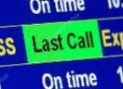





…the history of lh initiative
1ST REVOLUTION
Innovation
2ND REVOLUTION
PRECURSORS
SCC-01-2014
SCC-01-2016
SCC-01-2018
EU GREEN DEAL
Energy
Energy
CALL - 2011
CALL - 2012
Mobility
SCC-01-2015
SCC-01-2017
PED/PEB
SCC-01-2019
Enabled by ICT
Positive Annual balance
Eco-building projects
CONCERTO
PPP EeB
PPP EeB
Buildings
Energy Efficiency
Smart Cities EIP-SCC
EIP-SCC / SSC – Smart Cities And Communitiies Lighthouse projects
RES
BEMS
SCC - CALL Area
Nature Based Solutions
Large-Scale Demonstration
HEU MISSIONS
Renaturing Cities
SCC-02-2016
SCC-01-2020
Horizon 2020

Slide 4
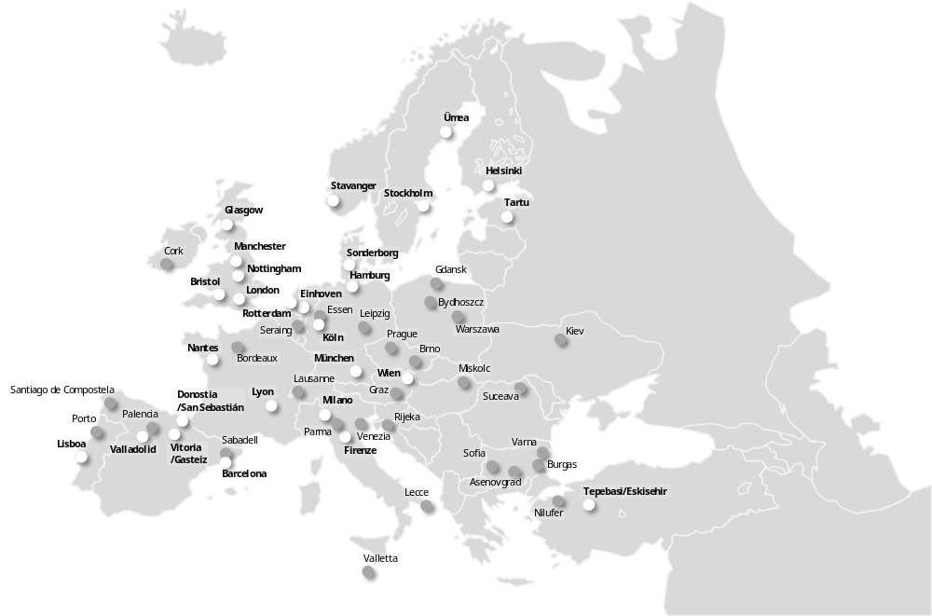



Lighthouse projects cooperation
“REMOURBAN is one of the main promoters of the collaboration”

Slide 5
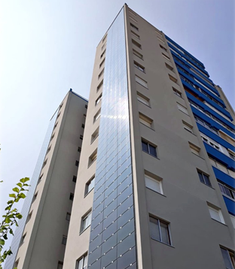
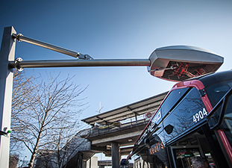
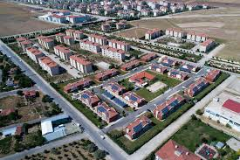
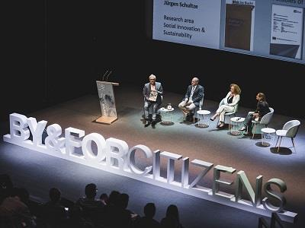
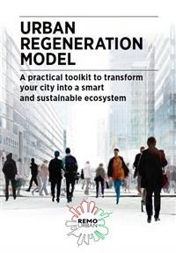

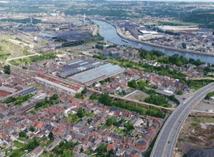
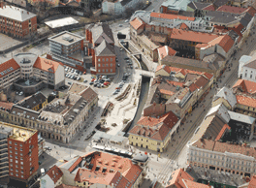
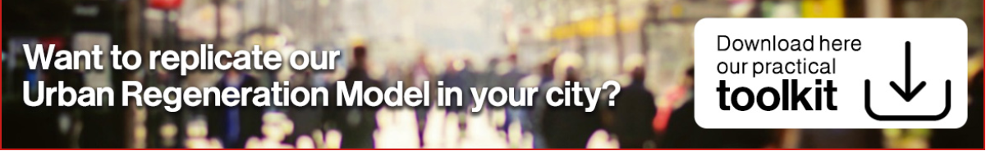
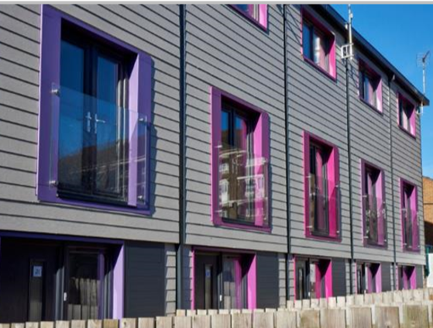
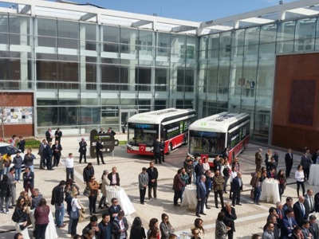
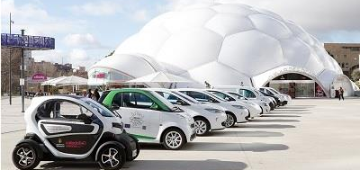
REMOURBAN HAS BEEN…
SERAING
MISKOLç
VALLADOLID
NOTTINGHAM
TEPEBASI

Slide 6
and apart from that…

Slide 7





















…A GREAT FAMILY OF FRIENDS

Slide 8
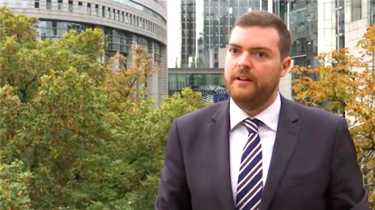
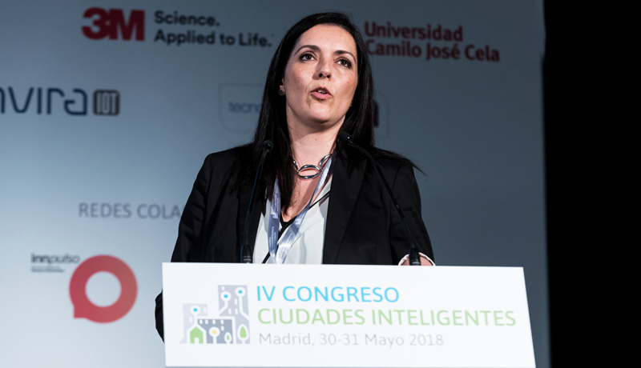
… A FLAGSHIP PROJECT IN ALL SENSES

Slide 9
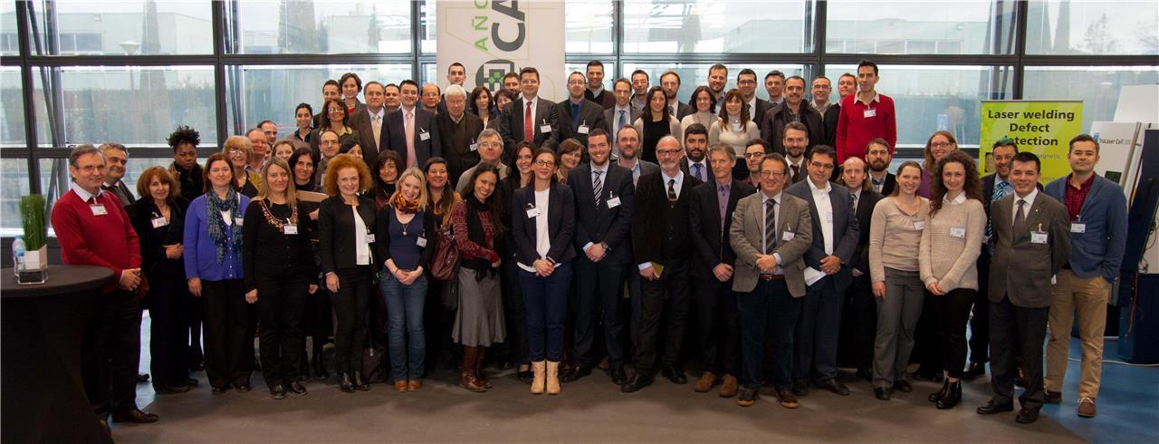
CONGRATULATIONS

Slide 10
Thank you for your attention!

