Slide 1

The role of cities to transform the economy
Dr. Miimu Airaksinen, CEO at Finnish Association of Civil Engineers RIL
Member of Mission Assembly Board Climate Neutral and Smart Cities
Picture Shutterstock
Picture Shutterstock

Slide 2
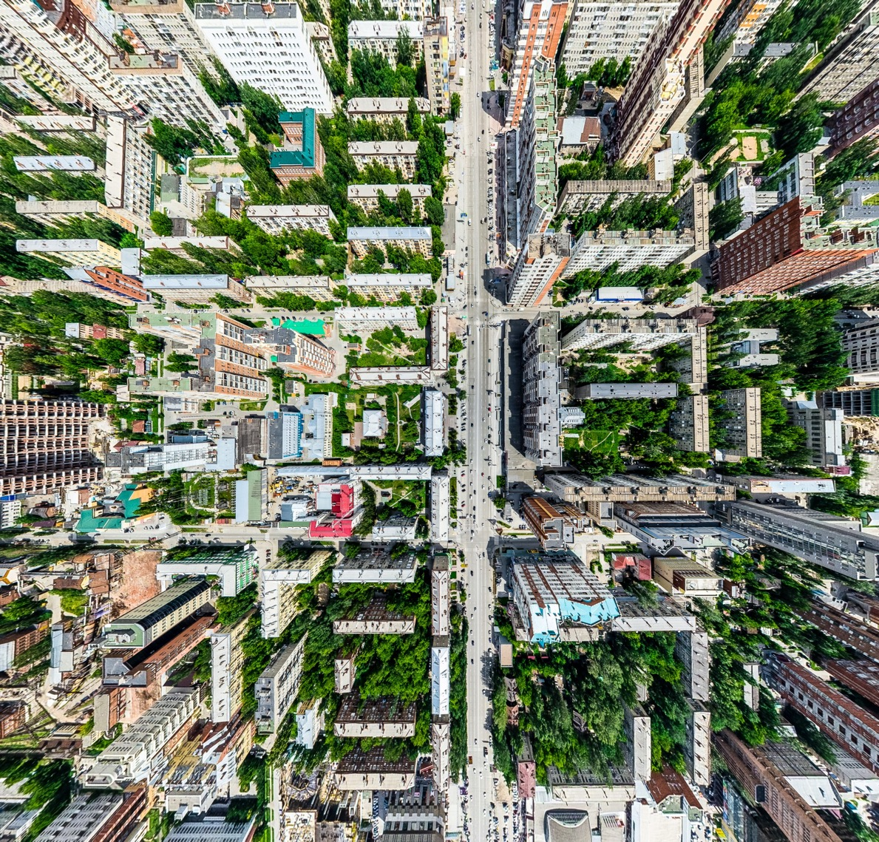
Urbanisation is a big megatrend
54% of the global citizens are living in cities and the trend is increasing
(78% in Europe)
70% of the GDB is created in cities
(85% in Europe)
90% of all innovations are created in cities
At the same time over 70% of all CO₂ emissions are originated from cities
Need for smart buildings and infrastructures to support sustainable and convenient living and working in cities
Picture Shutterstock
Picture Shutterstock
Notes:
Cities account for 85% of global GDP generation and are also huge collectors of materials and nutrients, accounting for 75% of natural resource consumption. Cities also produce 50% of global waste and 60-80% of greenhouse gas emissions. These are symptoms of the ‘take, make, waste’ linear economy.
Thriving cities in which economic productivity increases through reduced congestion, eliminated waste, and reduced costs. New growth and business opportunities support skills development and jobs
Liveable cities with improved air quality, reduced pollution, and enhanced social interactions
Resilient cities, reducing reliance on raw materials by keeping products in use and balancing local production with global supply chains

Slide 3
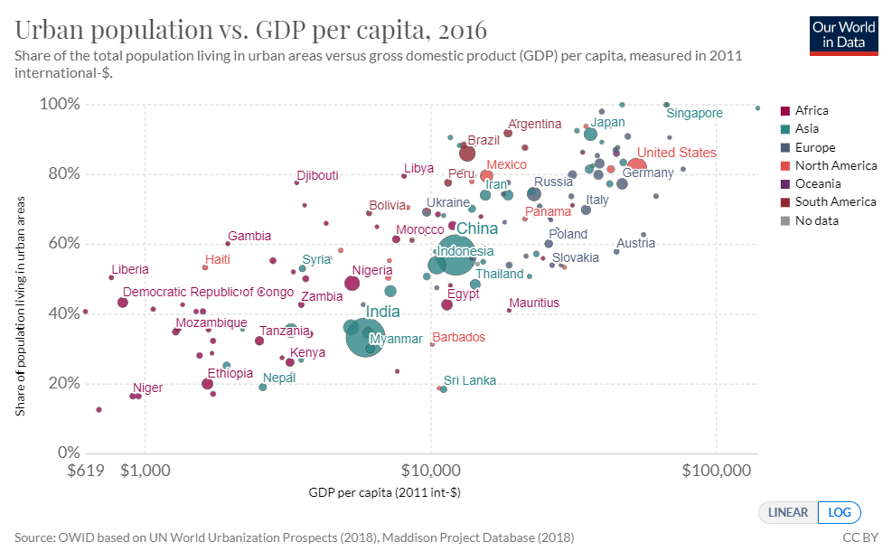
Notes:
In the chart we show the relationship between the share of the population living in urban areas (y-axis) and average income (gross domestic product per capita) on the x-axis. Here we see a strong relationship between urbanization and income: as countries get richer, they tend to become more urbanized.
The link between urbanization and economic growth has been well-documented.^{14,15,16}
Urbanization is complex, however there are many recognised benefits of urban settings (when developed successfully) including high-density of economic activity, shorter trade links, utilisation of human capital, shared infrastructure and division of labour.^{17,18,19}
Is there a causal feedback by which urbanization is also a predictor of future economic growth? The evidence for this is relatively weak — assessments of this effect suggest that countries with a higher initial urban population share do not achieve faster or slower economic growth than countries with a low initial urban population share.²⁰

Slide 4
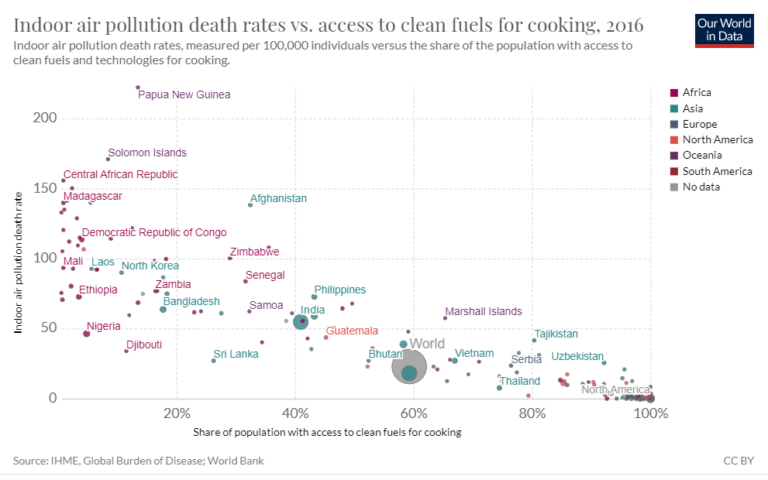
Urban populations tend to have higher living standards
in nearly all countries electricity access is higher in urban areas than in rural areas;
access to improved sanitation is higher in urban areas;
access to improved drinking water is higher in urban areas;
access to clean fuels for cooking and heating is higher in urban areas;
child malnutrition is lower in urban settings.
Note, a strong correlation with income. Furthermore, there can also be significant inequalities within urban areas
Notes:
Urban populations tend to have higher living standards
There are many examples — across broad areas of development — which suggest that, on average, living standards are higher in urban populations than in rural. Some examples include:
in nearly all countries electricity access is higher in urban areas than in rural areas;
access to improved sanitation is higher in urban areas;
access to improved drinking water is higher in urban areas;
access to clean fuels for cooking and heating is higher in urban areas;
child malnutrition is lower in urban settings.
Note, however, that it is difficult to infer causality between urbanization and these examples. Since urbanization shows a strong correlation with income, such relationships may instead simply show the effect of higher incomes on electricity access, sanitation, drinking water and nutrition. Furthermore, there can also be significant inequalities within urban areas; this is evidenced by the fact that across many low-to-middle income countries a high share of the urban population live in slum households (which lack access to all of the basic resources).

Slide 5
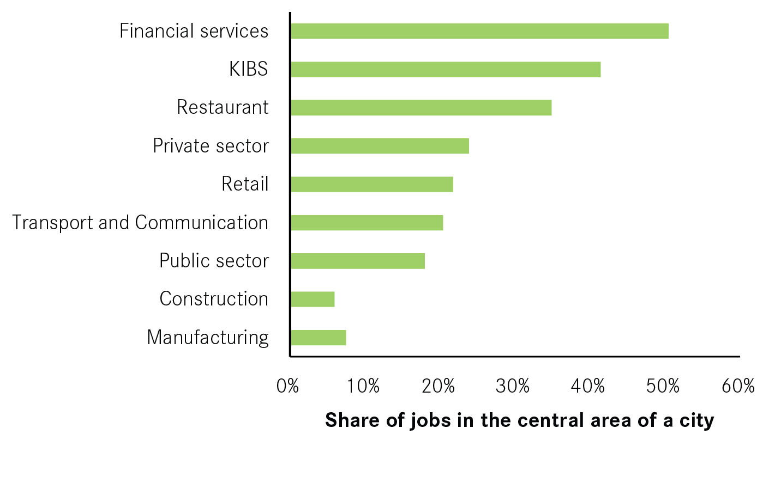
Cities and economy
Cities benefits:
The ability to share inputs and infrastructure, such as roads, rail and street lights
The ability to recruit from a deep pool of workers with relevant skills
The ability to exchange ideas and information, known as ‘knowledge spillovers’
knowledge intensive business services
Source: ONS Business Demography Database

Slide 6
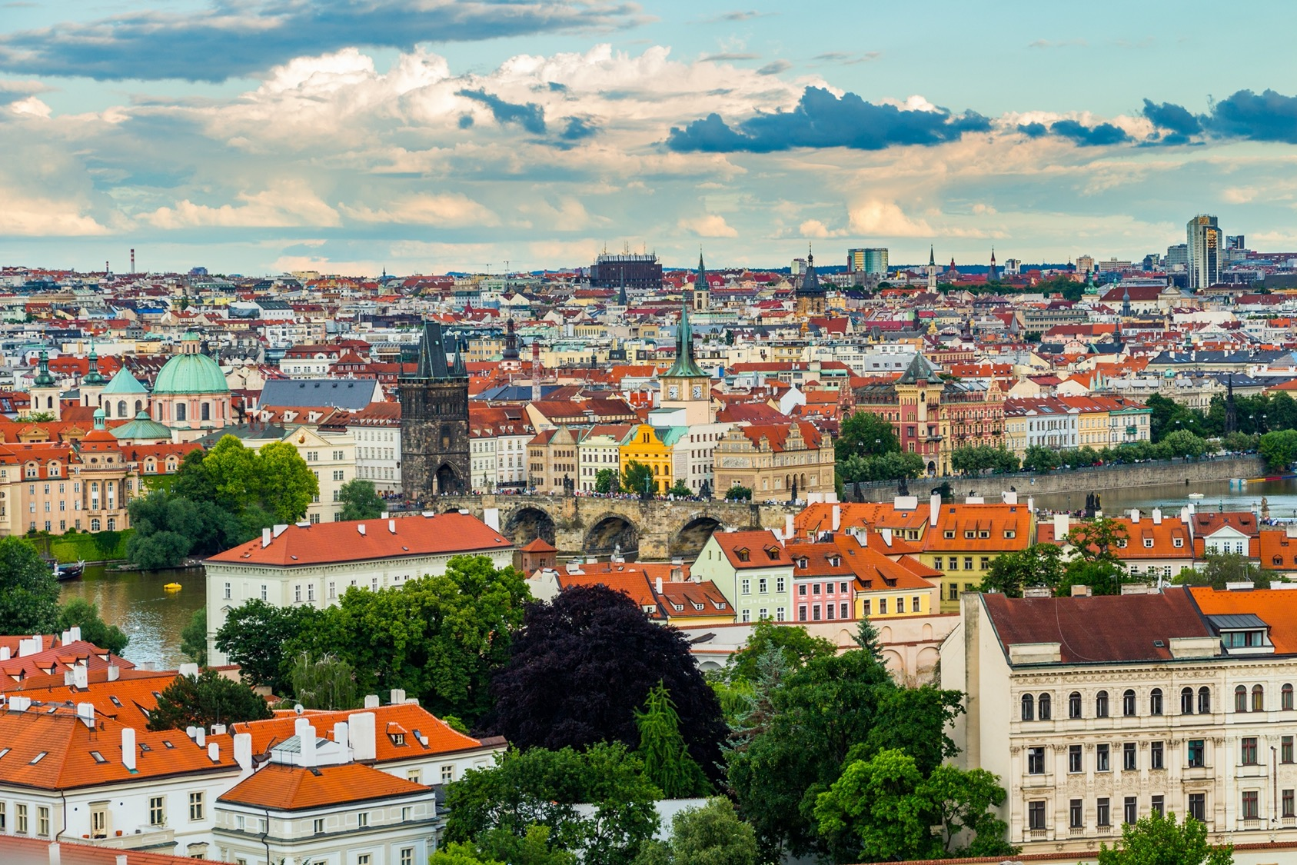
City Clusters
Figure Shutterstock
City clusters are also important since they have different needs and demands. Industries form vertical and horizontal linkages with other industries that supply their inputs or market and sell their products or services.
Three mechanisms enhance productivity:
1. An entire industry may benefit from agglomeration, since the size of the agglomeration provides sufficient demand to allow individual firms with internal scale economies to develop differentiated products.
2. An individual firm may benefit from the option to buy more specialized inputs at lower transaction costs from differentiated input suppliers within the region.
3. An individual firm may benefit from knowledge flows outside the market (spillovers) that arise from proximity within an agglomeration.

Slide 7
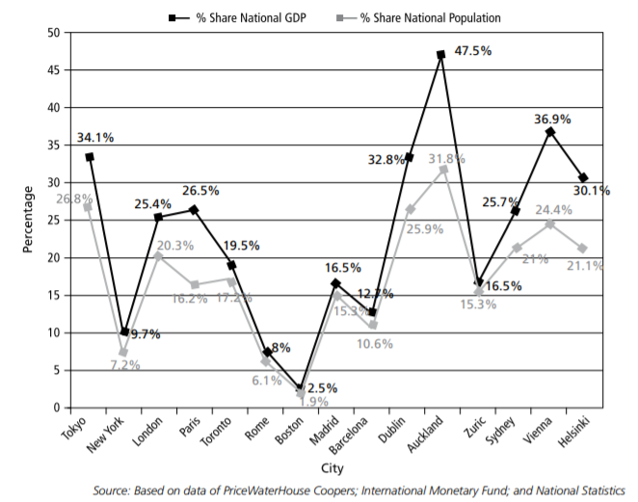
Higher productivity in cities (developed countries)
Cities have higher productivity, but when cities grow to certain levels, they start to produce negative impacts such as overcrowding, congestion and pollution.

Slide 8
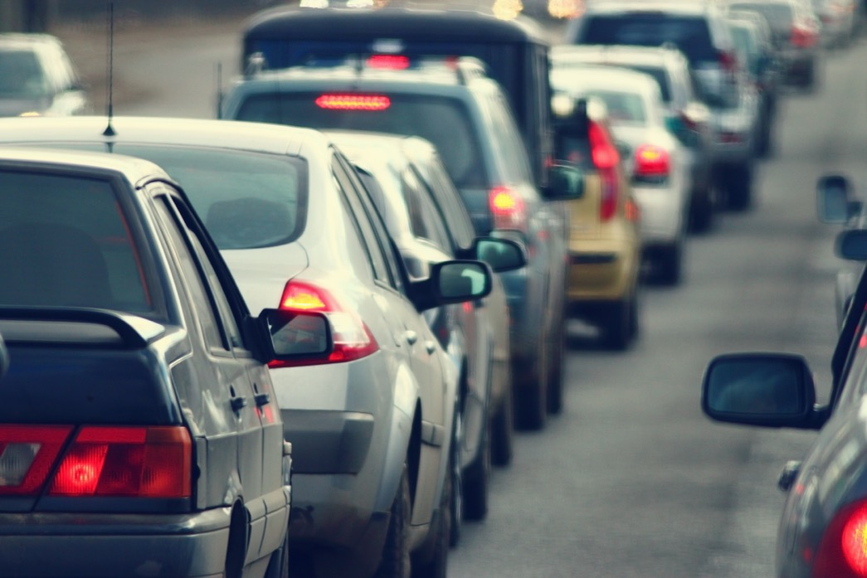
Access to jobs and CO2 emissions
Public transport is important. E.g. in UK the top 10 cities that have the lowest road transport CO2 emissions had on average 27 per cent of all jobs in their central areas (in 2011), while the 10 cities with the highest emissions on average had 17 per cent of all jobs located in their central areas.
Note, public transport is important also because not all people have access to own car
Figure Shutterstock

Slide 9
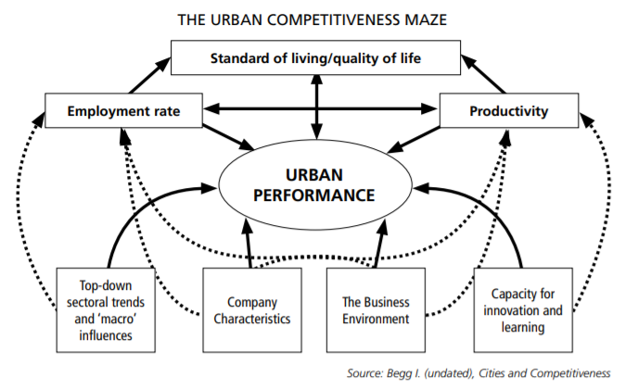

Slide 10

Efficiency = | Quality of Life
 | Environmental pressure * Use of Resources* Costs
Picture Shutterstock

Slide 11
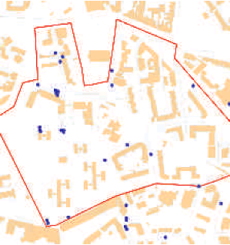
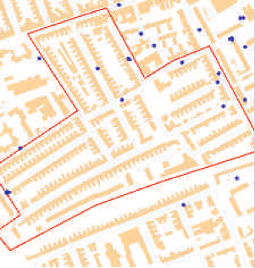
Urban planning and structure have a key role

Slide 12

When compared to people's regular activity patterns, certain weather conditions affected people's movements and activities noticeably at different times of the day
(Horanont et al 2013)
Weather
and
user behavior

Slide 13
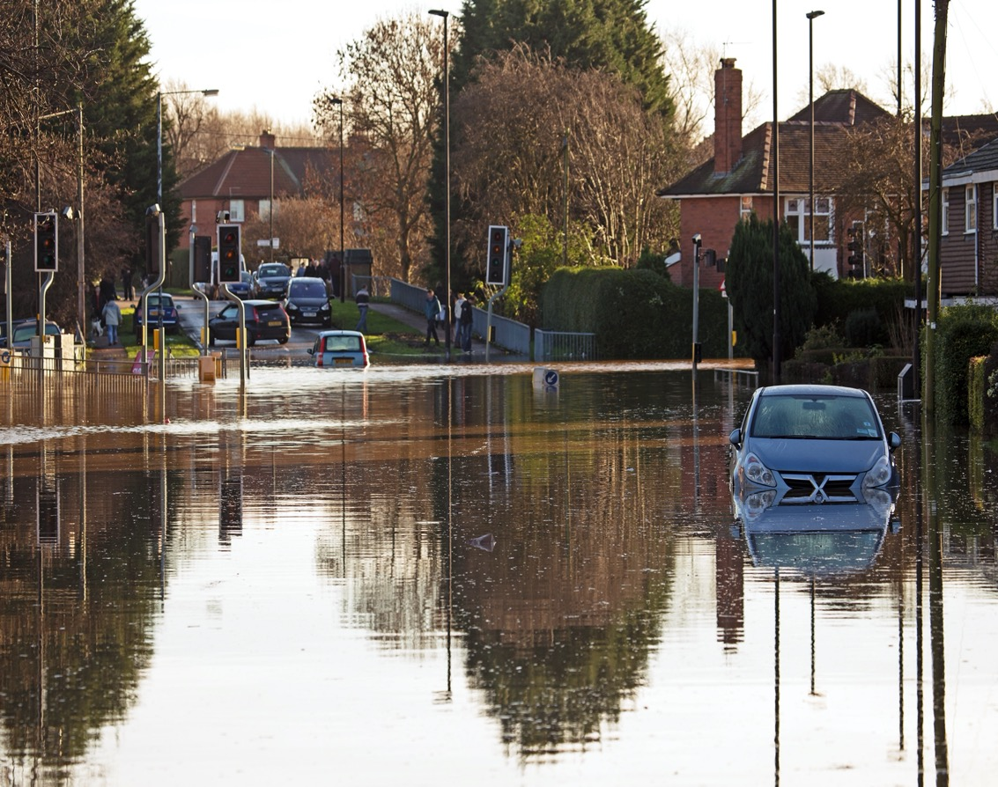
Resilience is important in cities
The economic losses caused by weather- and climate-related extremes in the 33 European Environment Agency member countries between 1980–2016 was over 450 billion euros.
Main reasons were:
floods ~40%
storms 25%
droughts ~10%
heat waves ~5%
The insurance coverage is 35 %.
Regarding impacts on human health, heat waves are the deadliest.
Picture Shutterstock
Notes:
Arvoketjujen muutos

Slide 14

Nature Based Solutions
source: https://thought-leadership-production.s3.amazonaws.com/2017/09/25/13/34/04/fab4e7a8-2d03-4a7d-83d8-bdcff6d0ce22/Cities_Tree_Infographic-02.jpg

Slide 15

What citizens want?
People are adaptable
Privacy
Green, blue areas
Services close
No time-consuming commuting
Affordability
Open space

Slide 16

What kind of city and to whom?
Existing buildings and infrastructures in cities
Long life span of buildings and infrastructure
We are designing city structures for inhabitants who are not even born yet !
Adaptability of buildings and infrastructures
Picture M.Airaksinen

Slide 17
10 Principles for Liveable, High-Density Cities (ULI)
Long-term growth and renewal
Diversity and inclusiveness (diversity is not divisive)
Nature closer to people, Nature Based Solutions
Affordable, mixed-use neighborhoods
All space, including infrastructural spaces should serve multiple uses and users
Green transport and buildings
Density with variety and green boundaries
Sense of safety and security
Innovative and non-conventional solutions
People, Public, Private Partnerships
https://americas.uli.org/press-release/10-principles-singapore/

Slide 18
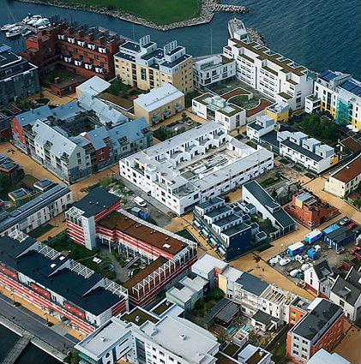
Adaptive and context aware cities are resilient

Slide 19

Everything is connected
Every second 127 devices are connected to the internet
Picture Shutterstock

Slide 20
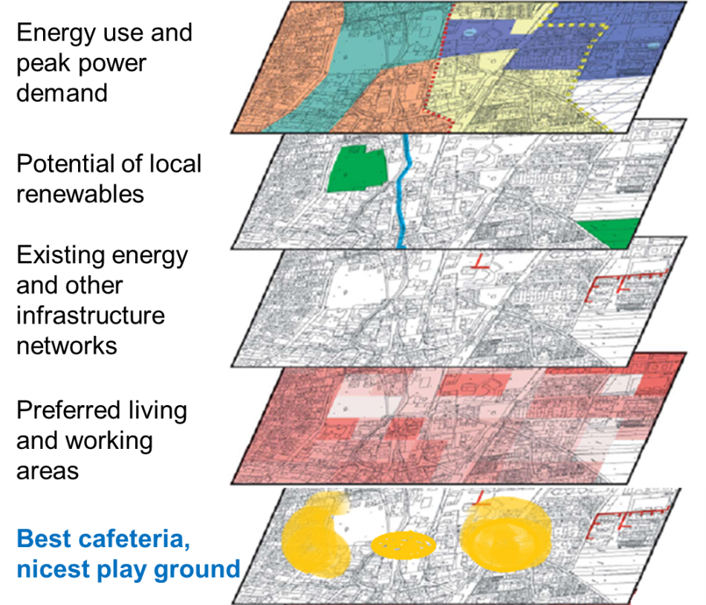
City-wide data must generate real insights (resilience)
Combining data from different sources
Since many systems are connected the decision making and leadership processes need to change.
In addition the business models are in transition (many stakeholders, new eco-systems)

Slide 21
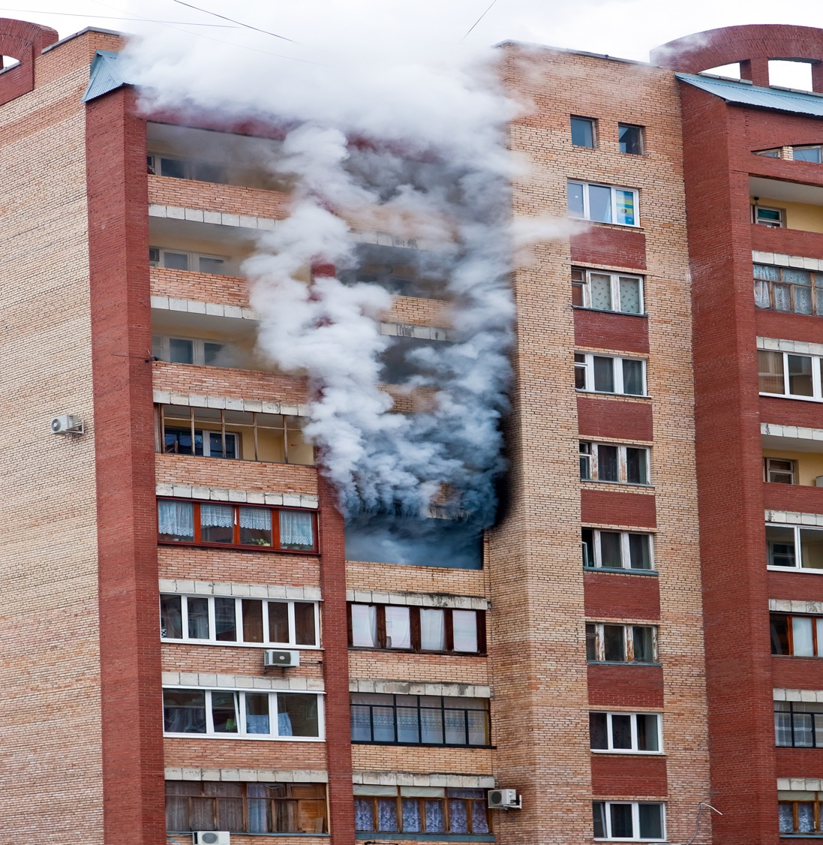
Data and privacy
Picture Shutterstock
Picture Shutterstock
Notes:
Arvoketjujen muutos

Slide 22

Cyper security
Only in Europe 315 million people are using internet daily
Different domains of our infrastructures are connected
Cyper security is a growing business area, the European market is estimated to be over 100 mrd $ (European Commission 2017)
The amount and quality of attacts is increasing, the World Economic Forum estimated that the global costs are 445 mrd $ yearly (WEF 2016)
Picture Shutterstock

Slide 23
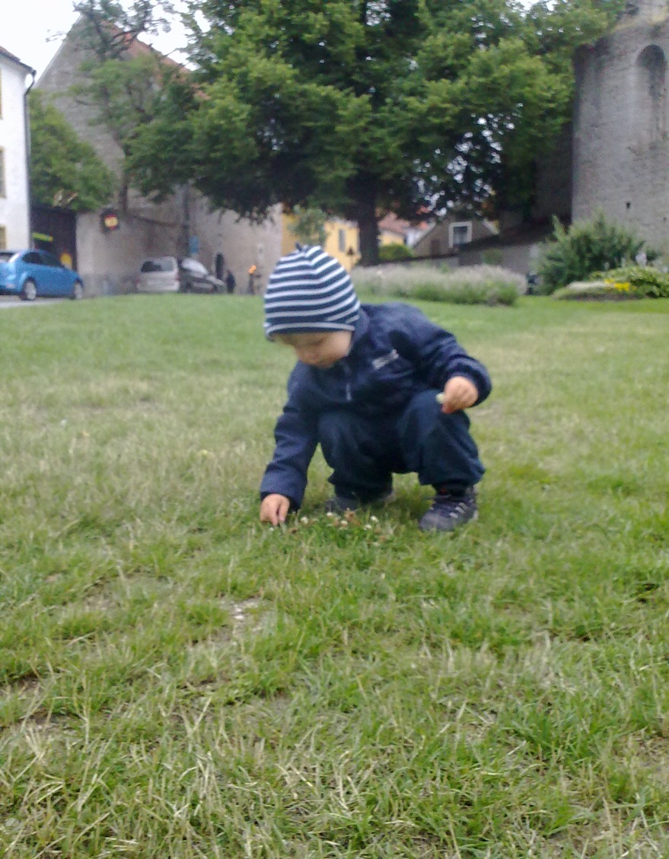
Services
Future services like
Living as a service
Just like a garden, the services are changing their color and form and they are perceived differently by different persons. Need for evolution of services.
Picture M Airaksinen

Slide 24

The future is always overpredicted
but underimagined
Picture M Airaksinen

