Slide 1
CARTIF Technology Centre
Miguel Á. GARCÍA-FUENTES
REMOURBAN Project Coordinator
REMOURBAN: transforming EU cities into smarter environments
REMOURBAN FINAL CONFERENCE

Slide 2
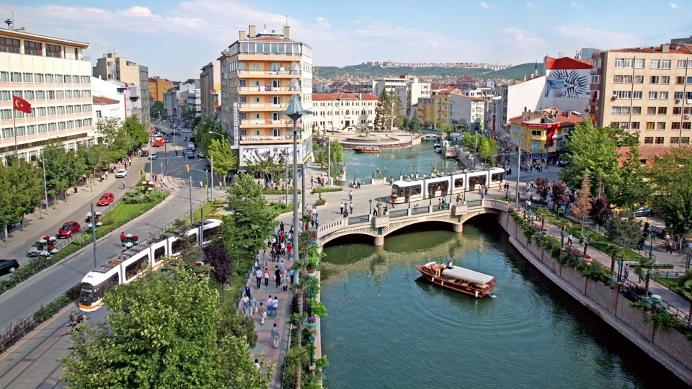

Slide 3
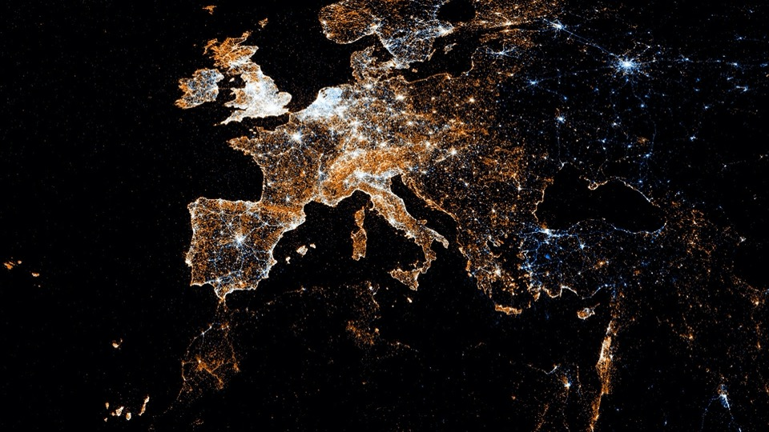
Source: Geotagged cities. Wired Magazine January 2012
[…] For me, my city is imposed as an indisputable evidence: the environment of everything or almost everything that happens to me, the greatest place among all I can modify, of all those where I can influence actually, physically, and not only through the fiction of the vote. […]
Pasquall Maragal. Mayor of Barcelona (1982-1997)
Preface to “Cities for a Small Planet” Richard Rogers, 2000

Slide 4
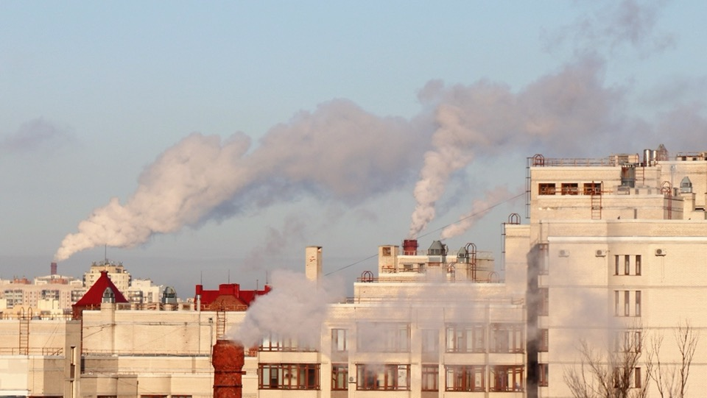
Biggest city challenges
environment, resources,
inequality, technology,
governance
and
new challenges

Slide 5
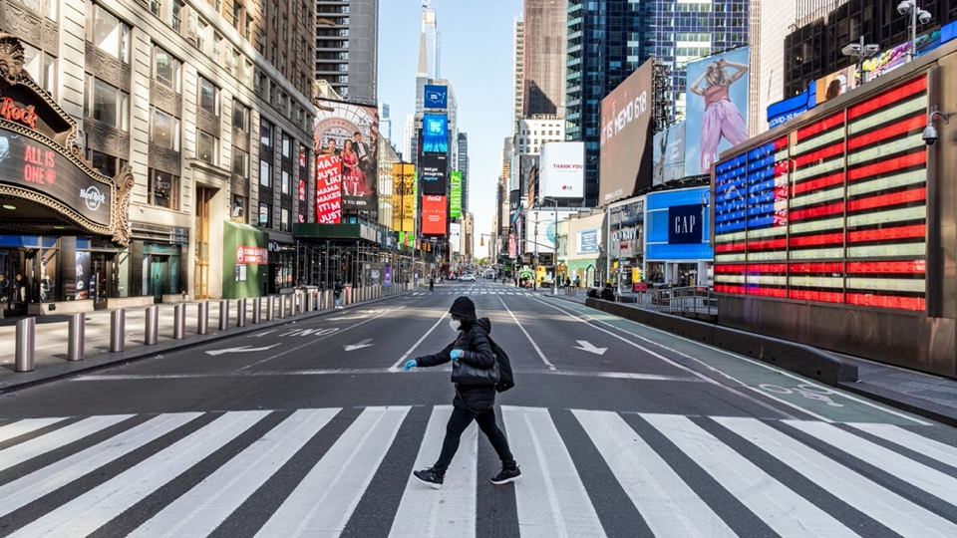
the right to the (smart) city
Notes:
El concepto de derecho a la ciudad no es novedoso, pero está plenamente vigente. Su origen lo encontramos en una obra clásica del pensamiento urbano: El derecho a la ciudad, de Henri Lefebvre. Un ensayo publicado en 1968 que denuncia la crisis de la vida cotidiana en la ciudad europea a mediados del siglo XX. Lefebvre analiza la conversión de la ciudad en una mercancía, al mismo tiempo que hace explícita su dimensión política y transformadora.
La actualidad de la obra seguramente se debe a que define el concepto de derecho a la ciudad desde la potencialidad emancipadora que ella contiene. Se refiere al derecho de «crear» ciudad como un reclamo de la vida urbana. De esta manera, se centra en la capacidad de las personas que habitan la ciudad de transformarla, y de transformarse como sociedad por medio de ella.

Slide 6
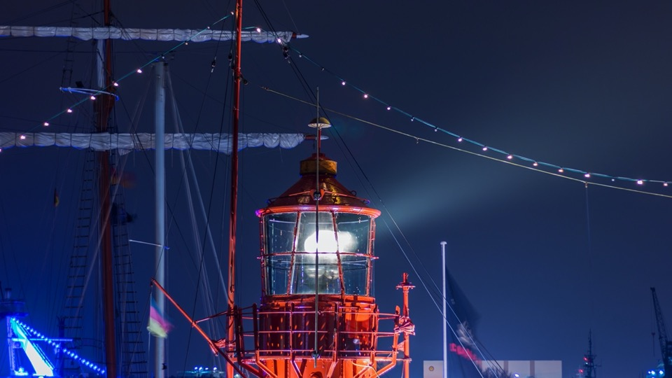
light the way of EU
cities
to face their current and upcoming challenges

Slide 7
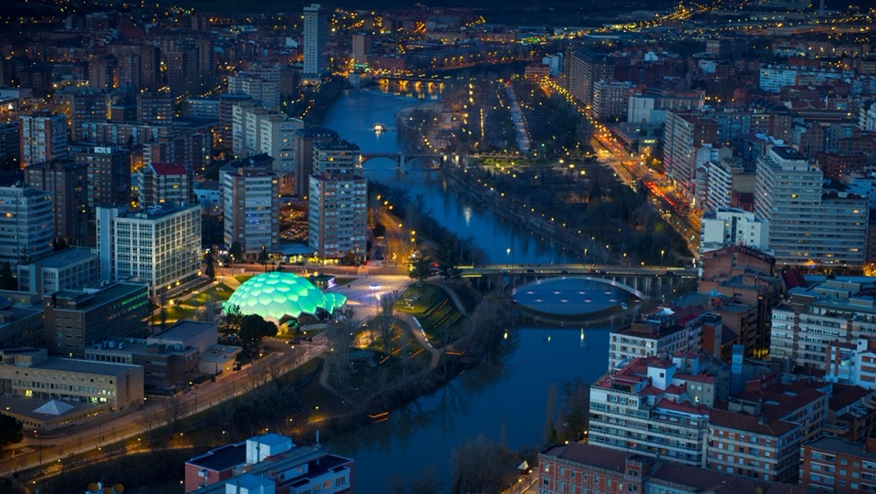
Source: Jason Hawkes. Valladolid: Cúpula del Milenio
the goal is providing a model to make cities
smarter
and more sustainable
Notes:
“Ciudad inteligente (Smart City) es la visión holística de una ciudad que aplica las TIC para la mejora de la calidad de vida y la accesibilidad de sus habitantes y asegura un desarrollo sostenible económico, social y ambiental en mejora permanente. Una ciudad inteligente permite a los ciudadanos interactuar con ella de forma multidisciplinar y se adapta en tiempo real a sus necesidades, de forma eficiente en calidad y costes, ofreciendo datos abiertos, soluciones y servicios orientados a los ciudadanos como personas, para resolver los efectos del crecimiento de las ciudades, en ámbitos públicos y privados, a través de la integración innovadora de infraestructuras con sistemas de gestión inteligente.”

Slide 8
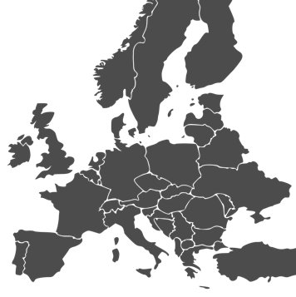











REMOURBAN project
Total REMOURBAN budget: 32.5M€ (21,5M€ EU funded)
Total investment in REMOURBAN actions: 22.9M€ (80% public)
Energy savings: 7,117 MWh/yr
CO₂ emissions avoided: 2,676 TnCO₂/yr
Citizens directly involved in demos: 19,800
Consortium: 22 partners (5 municipalities, 3 RTD, 5 industries, 9 SMEs)
Nationalities: 7 (Spain, UK, Turkey, Belgium, Hungary, Germany, Italy)

Slide 9
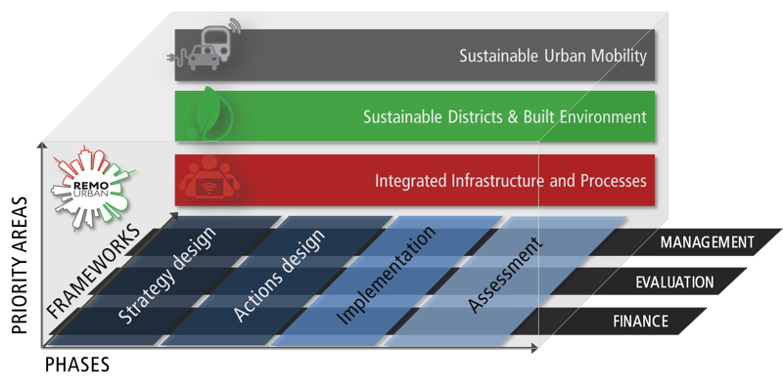
Our Urban Regeneration Model

Slide 10
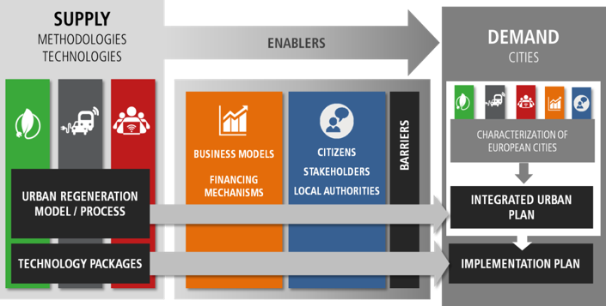
Our objective: replication

Slide 11
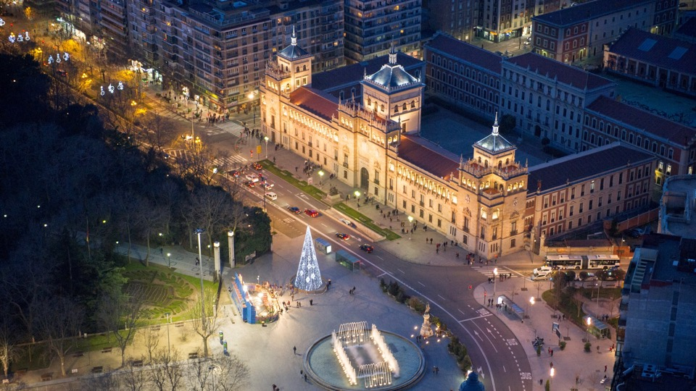
Valladolid
lighthouse city

Slide 12
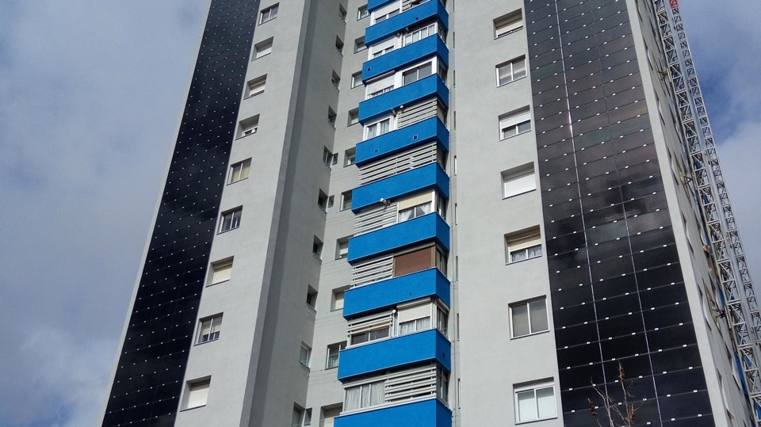

Slide 13
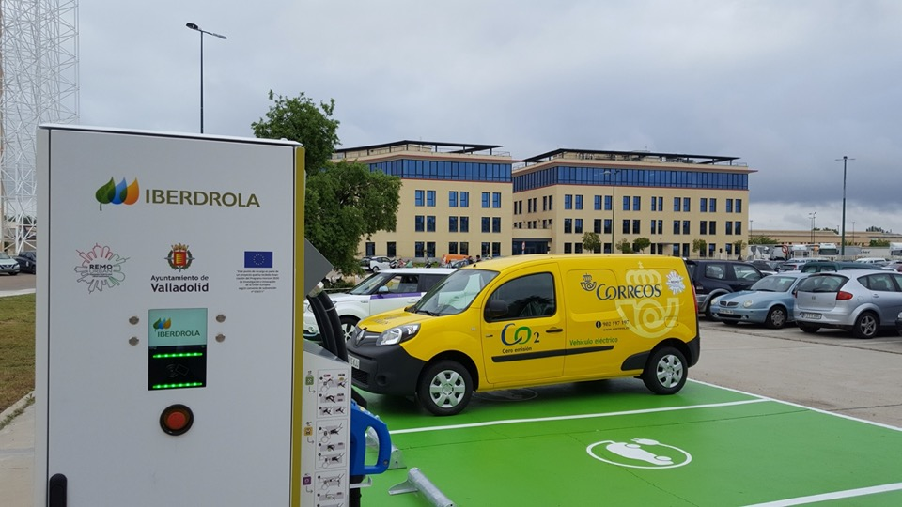

Slide 14
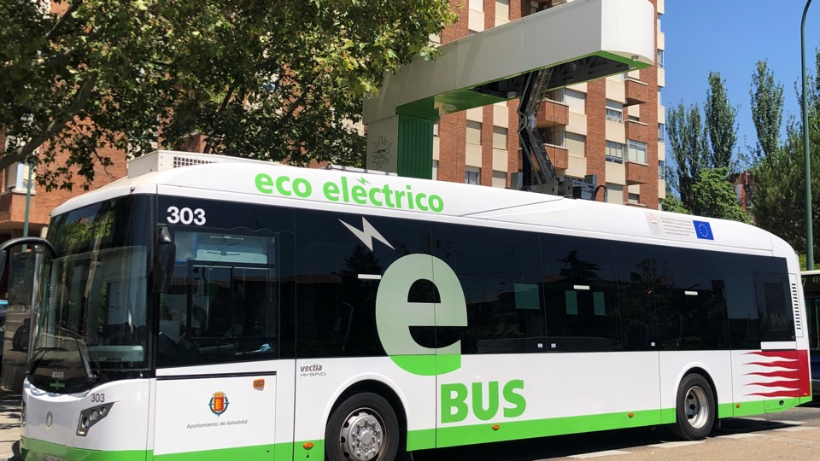

Slide 15
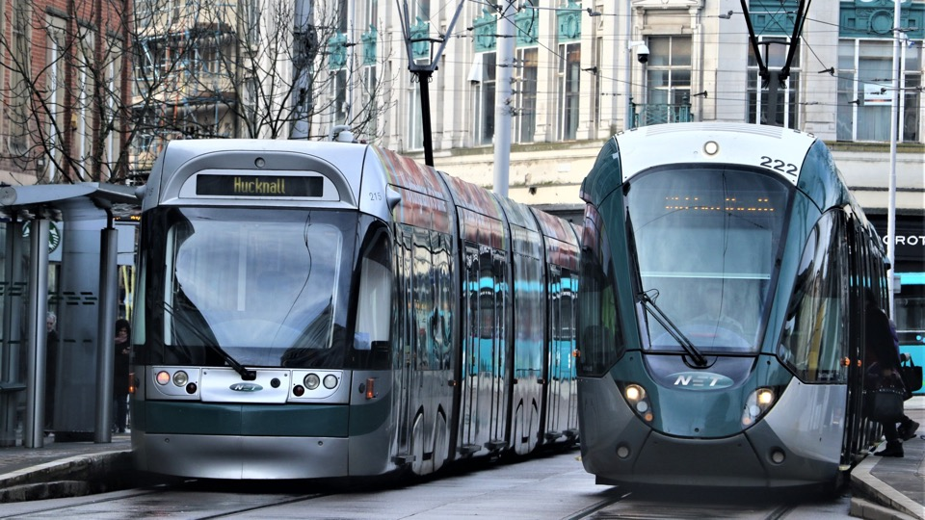
Nottingham
lighthouse city

Slide 16
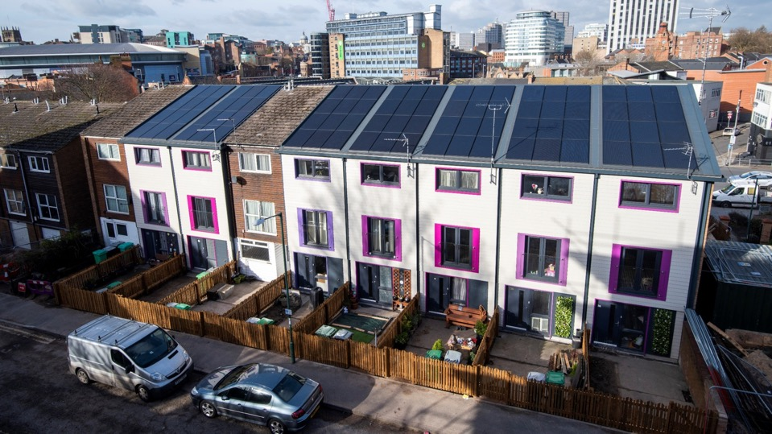

Slide 17
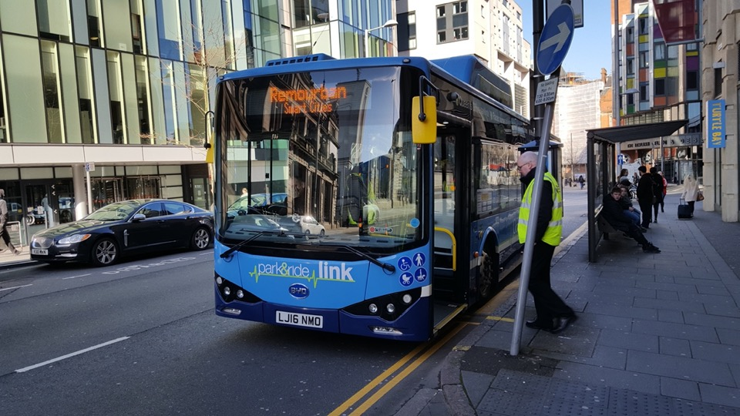

Slide 18
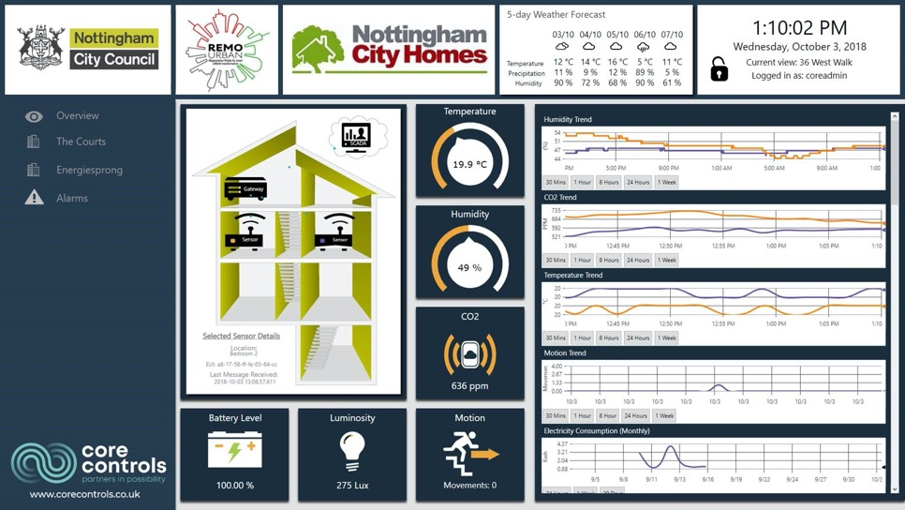

Slide 19
Tepebaşı
lighthouse city

Slide 20
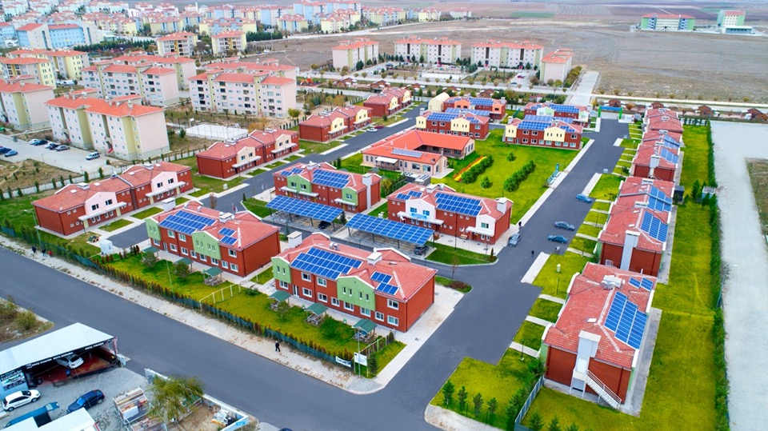

Slide 21
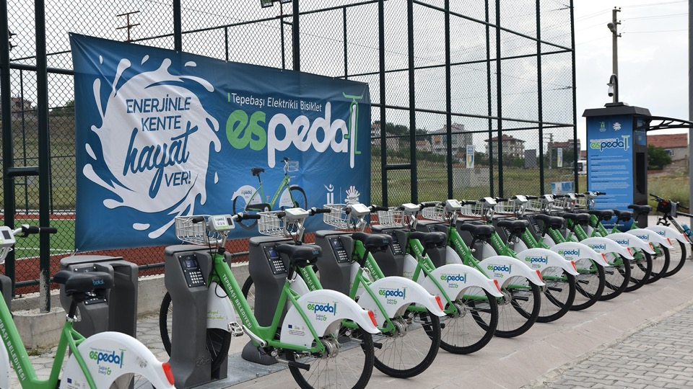

Slide 22
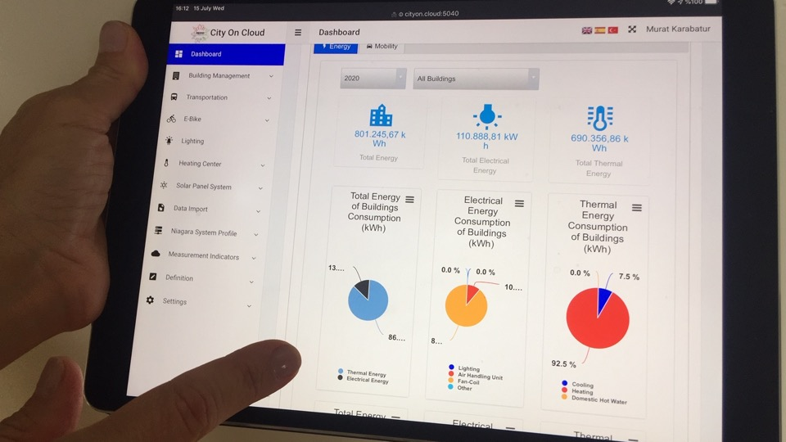

Slide 23
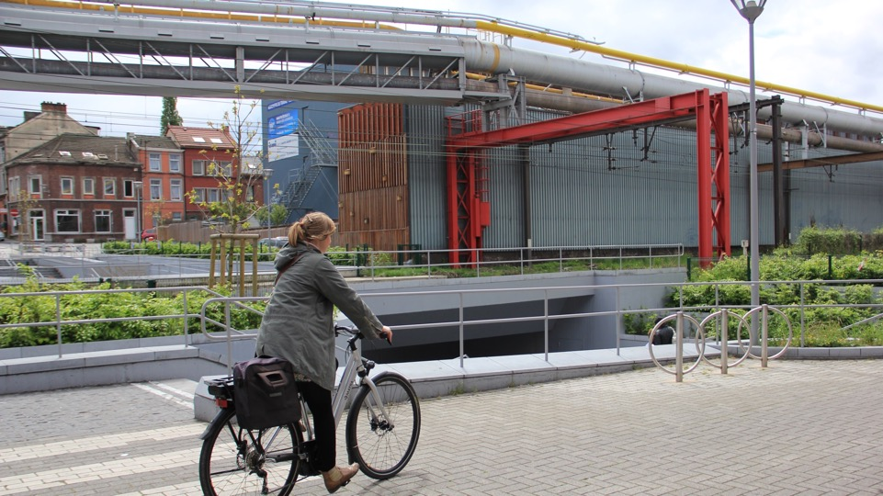
Seraing
follower city

Slide 24
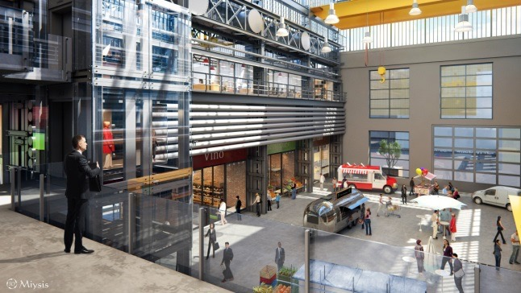

Slide 25
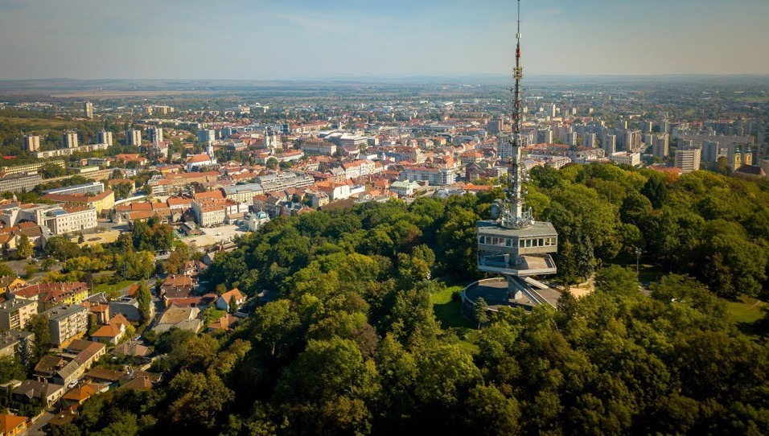
Miskolc
follower city

Slide 26
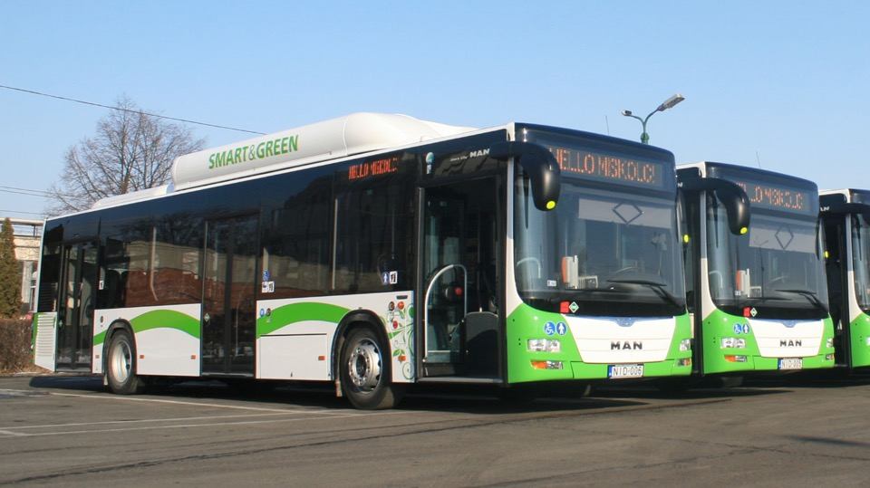
Notes:
Generally illustrated as evolving example of city transformation from old, deteriorated brownfield heavy industrial
profile to a greener, more attractive and liveable place – smart and green development in focus
Smart grid for public energy generators and buildings – office & residential @district&city level
Intelligent traffic management system – smart surveillance based
Introduction of e-buses+chargers – 2 tests carried out recently
(Public) e-vehicle charger infrastructure + ICT tools – deployment this year
Smart phone apps to aid mobility – for inclusion of city app. platform
Gamification for educational and engagement purposes – also @digital squares
Potential relevance of REMOURBAN solutions is seen beyond a single neighbourhood – rather on a broader scale in smart city planning and project implementation

Slide 27
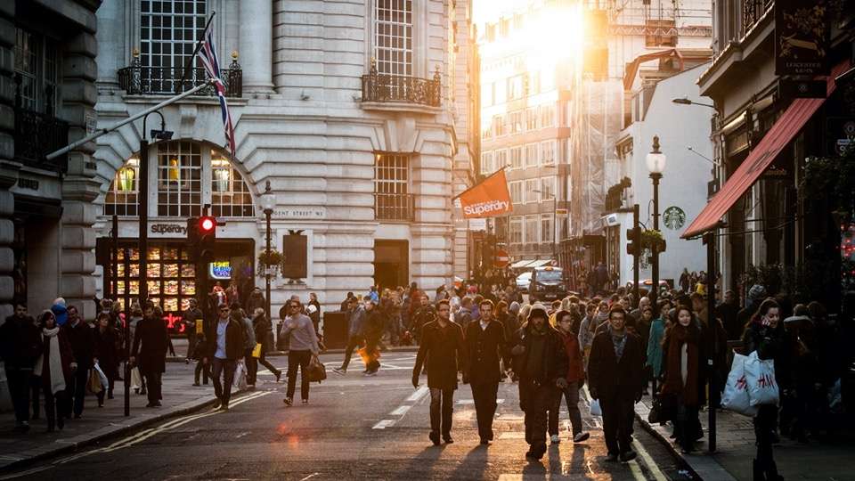
64.000 m² retrofitted
22 e-buses and 73 alternative fuelled vehicles
20 charging points for buses
75 charging points for public and private use
7.117 MWh/year energy savings
4.165 MWh/year RES production
2.676 tonsCO₂/year avoided

Slide 28

20.000 citizens directly involved in our actions
Outreach of more than 590.000 people
24 scientific publications
Contributed to the creation and sustainment of the Lighthouse Projects Collaboration

Slide 29
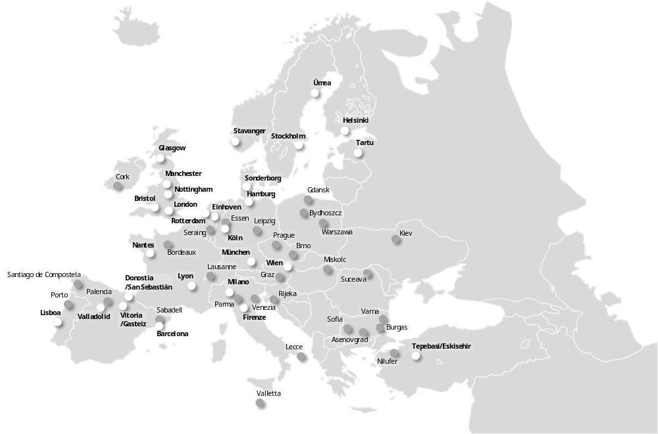
Lighthouse projects cooperation
116 cities paving the way towards a Smarter and more Sustainable Europe

Slide 30
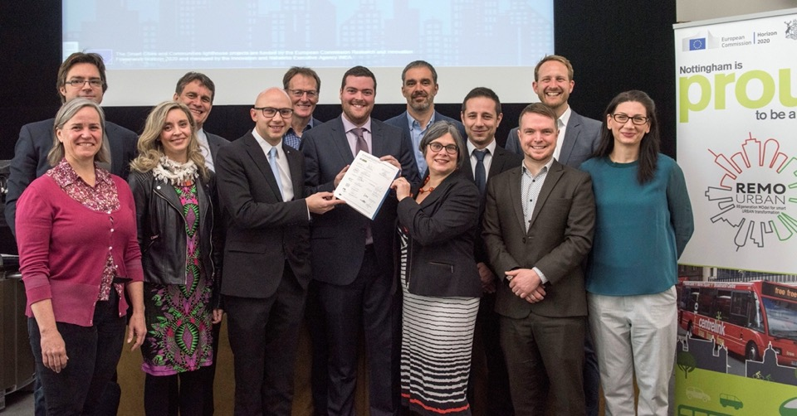

Slide 31
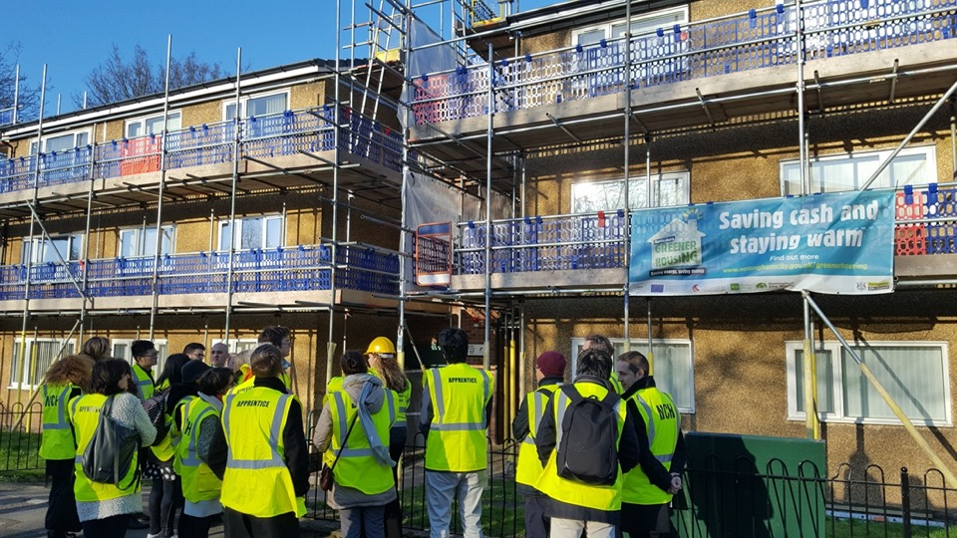

Slide 32
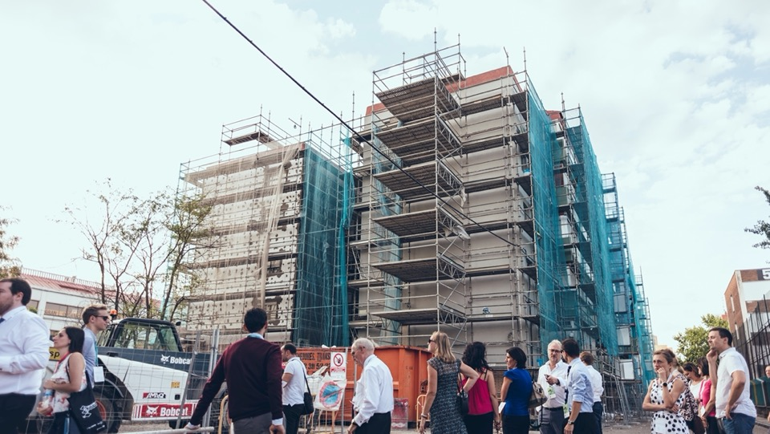

Slide 33
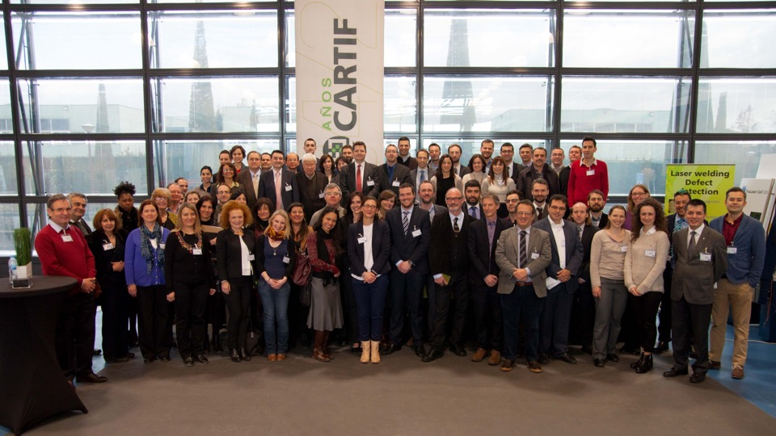
5 years ago

Slide 34
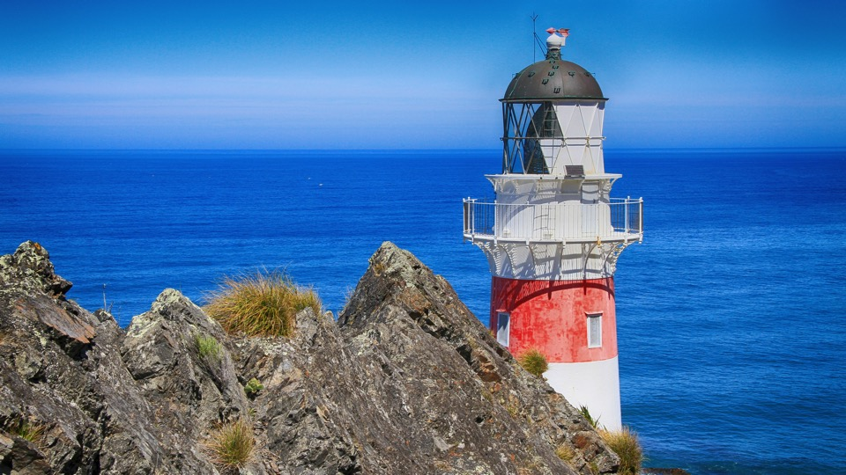
proud
to have contributed to delivering the
cities
of the
present

Slide 35
Thank you for your attention!

