Slide 1
SECAPs as drivers for smart and sustainable cities
Andy Deacon, Director of Strategy & Operations
Global Covenant of Mayors for Climate and Energy
July, 2020

Slide 2

The Global Covenant of Mayors for Climate & Energy is an international alliance of cities and local governments working to achieve a low-emission and climate resilient future.
The GCoM serves cities and local governments of all sizes in all parts of the world
The movement supports ambitious, measurable, planned climate and energy action in communities
It achieves this by working closely with city and regional networks, national governments, and other local and international partners

Slide 3
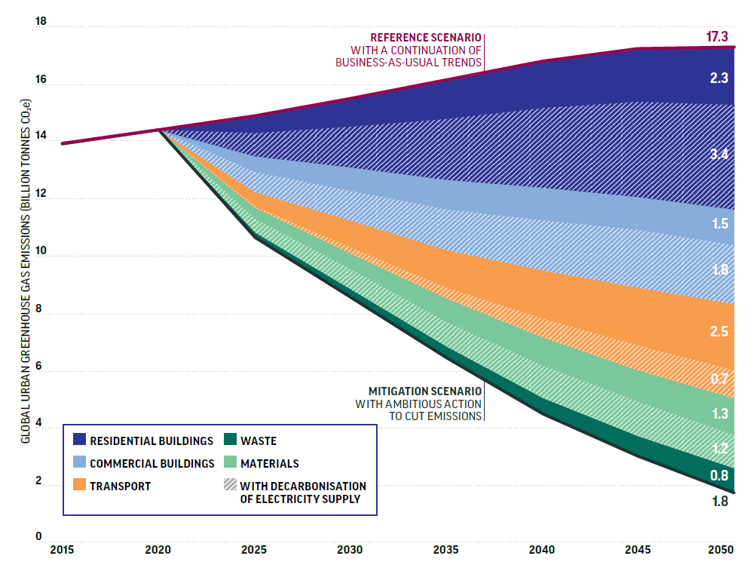
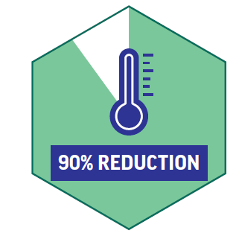
We know the pathway to zero-carbon cities
IN URBAN EMISSIONS
BY 2050
Source: Stockholm Environmental Institute for the Coalition for Urban Transitions, 2019
Notes:
It is possible to cut 90% of emissions from cities (15.5 GtCO2e by 2050) using proven technologies and practices.
SHORT: Decarbonising electricity contributes a substantial share of the emissions reductions potential in every sector. Beyond that, buildings have the largest role (3.8 GtCO2e by 2050), followed by the transport sector (2.5 GtCO2e by 2050).
LONG: In absolute terms, these savings are greater than the combined 2014 energy-related emissions of the two largest emitters, China and the U.S. 58% of these carbon savings come from the buildings sector, 21% from the transport sector, 16% from materials efficiency and 5% from the waste sector
Overall, urban sectors can contribute 62% of global energy-related GHG reductions needed for a 2C pathway in 2030, and 58% of global energy-related GHG reductions needed for a 2C pathway in 2050.

Slide 4
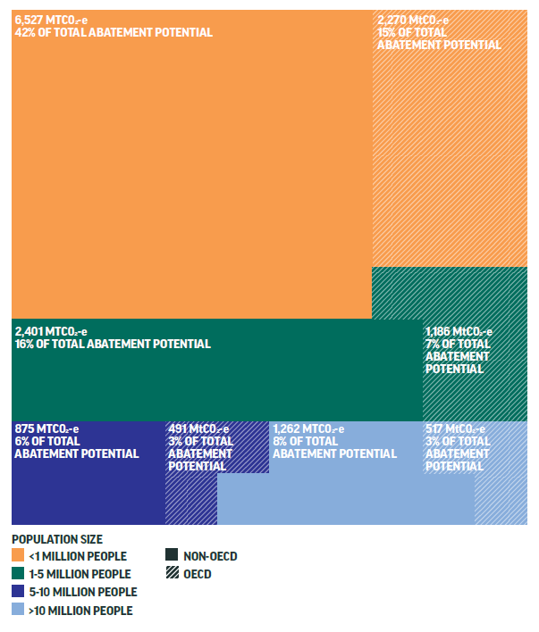
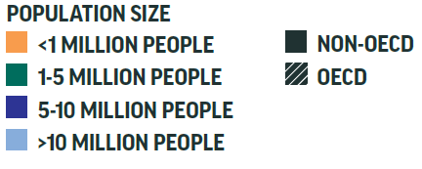
Over half of the urban abatement potential globally is in cities with fewer than 1 million residents
Source: Stockholm Environmental Institute for the Coalition for Urban Transitions, 2019
Notes:
Fully half of the possible urban emissions reduction must happen in cities with fewer than 750,000 people,
These small and medium size cities often lack the financial and technical resources of larger cities and therefore are in particular need of national government support.

Slide 5
Key Elements of a Successful SECAP
Build support from stakeholders and citizen participation
Secure a long-term political commitment
Ensure adequate financial resources
Do a proper GHG emissions inventory as this is vital
Make a Climate Change Risk and Vulnerability Assesmsent
Integrate the SECAP into everyday management processes of the municipality: it should not be just another nice document, but part of the corporate culture!
Ensure proper management during implementation
Make sure that staff has adequate skills, and if necessary offer training
Learn to devise and implement projects over the long term

Slide 6

A reference framework for action
Consistency and transparency thanks to a common reporting framework for all, flexible and adjustable to local realities
High visibility via personalised signatory profiles on the Covenant website
Evaluation of the data reported by the Commission's independent scientific centre

Slide 7
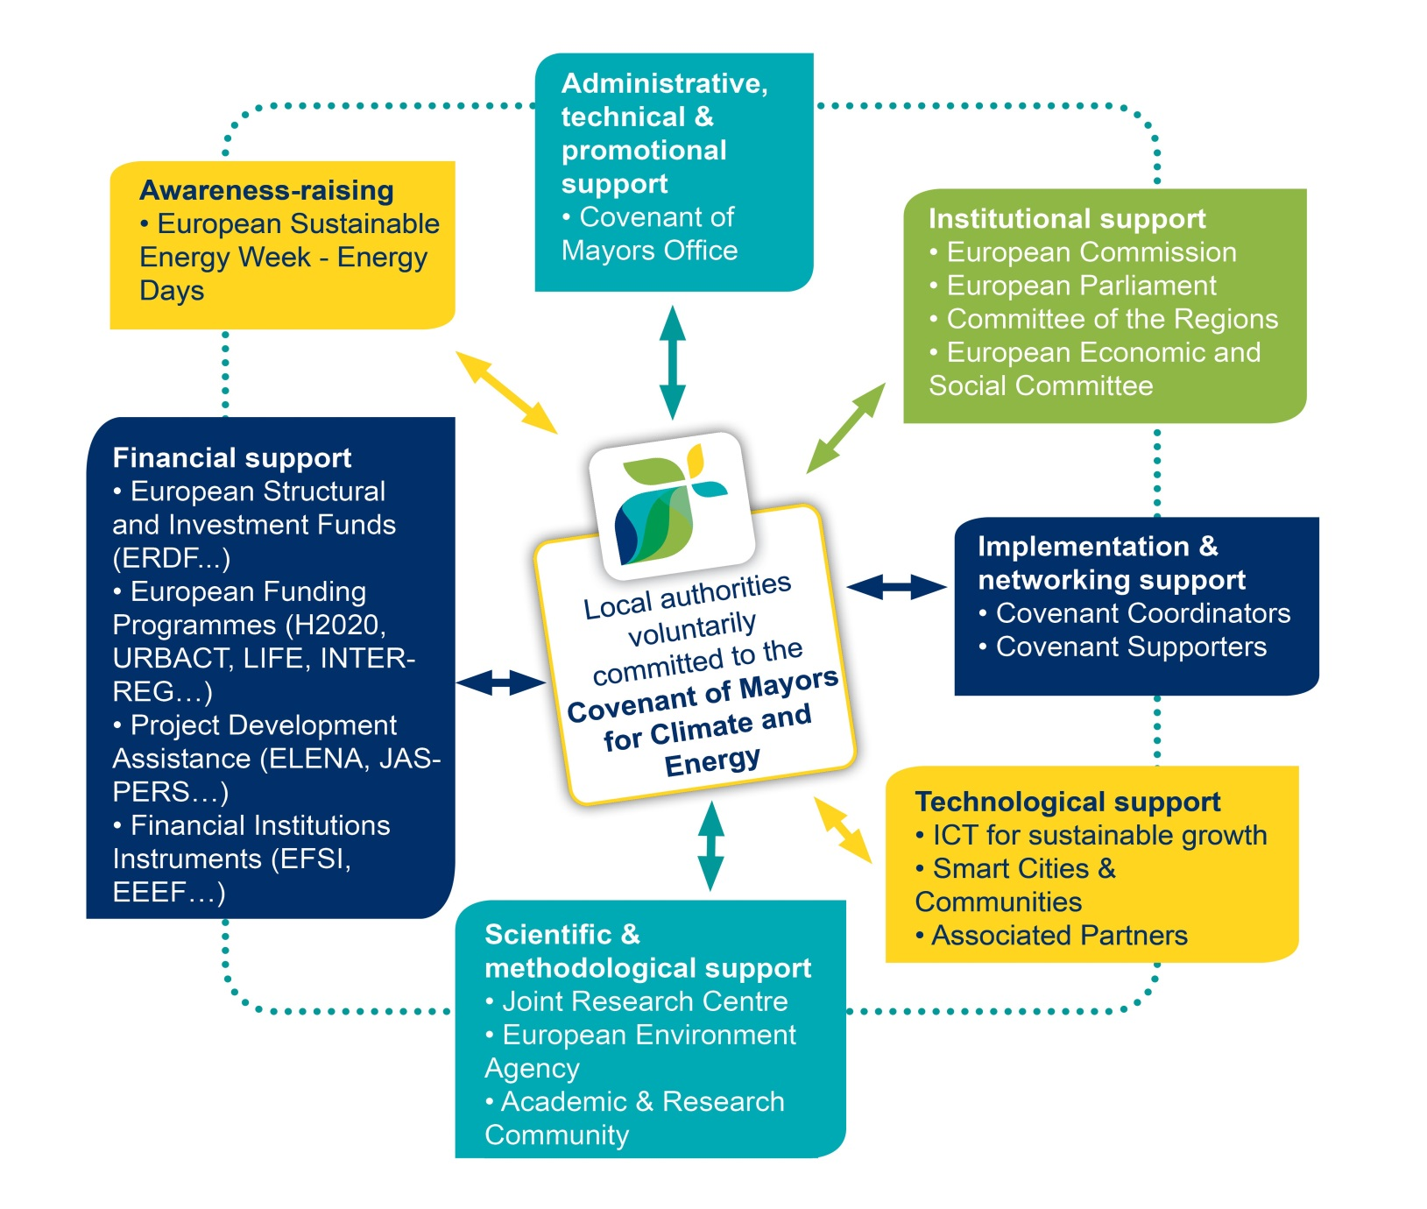
Multi-stakeholder involvement

Slide 8
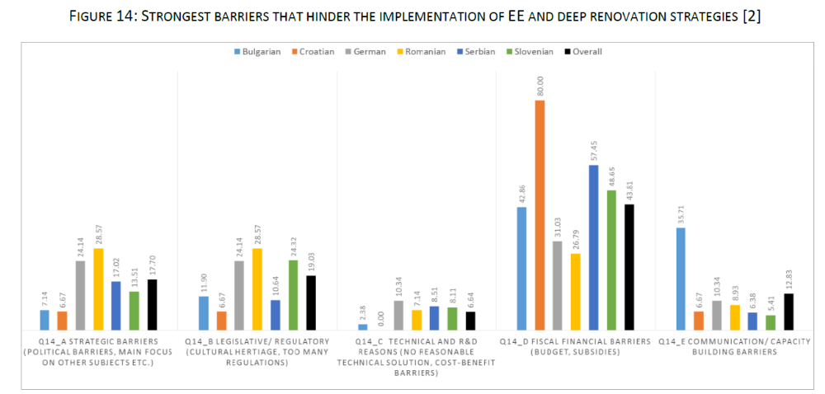
EMBuild Project Findings

Slide 9



Methodology
Framework
Platforms
The City Climate Project Planning and Development Cycle
✓
Data Collection
Origination / Project Definition
Feasibility
Pre-construction
Implementation
Construction
Operation
Target-setting and Commitment
Pre-Feasibility
Procurement
Analyses, Scenarios, and Reporting
Climate Action Planning
Project Definition / Pre-Feasibility
Planning
Project Feasibility, Structuring, and Preparation
Transaction/Investment
Reporting

Slide 10
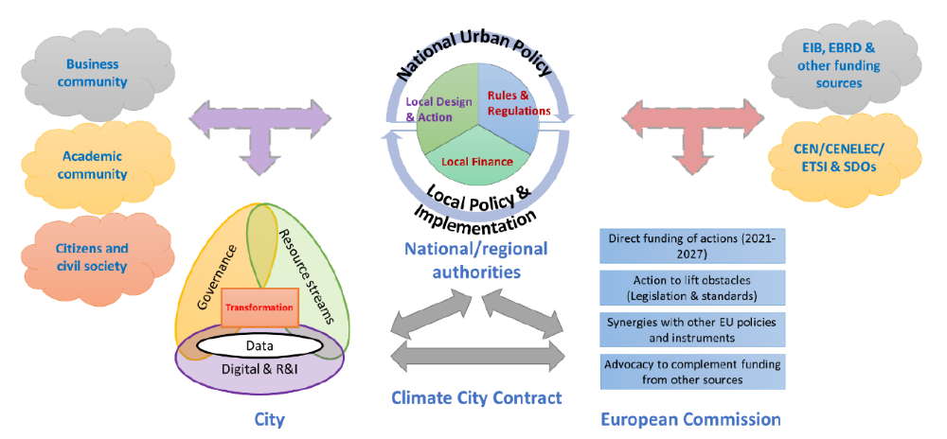
Carbon Neutral Cities Mission

Slide 11
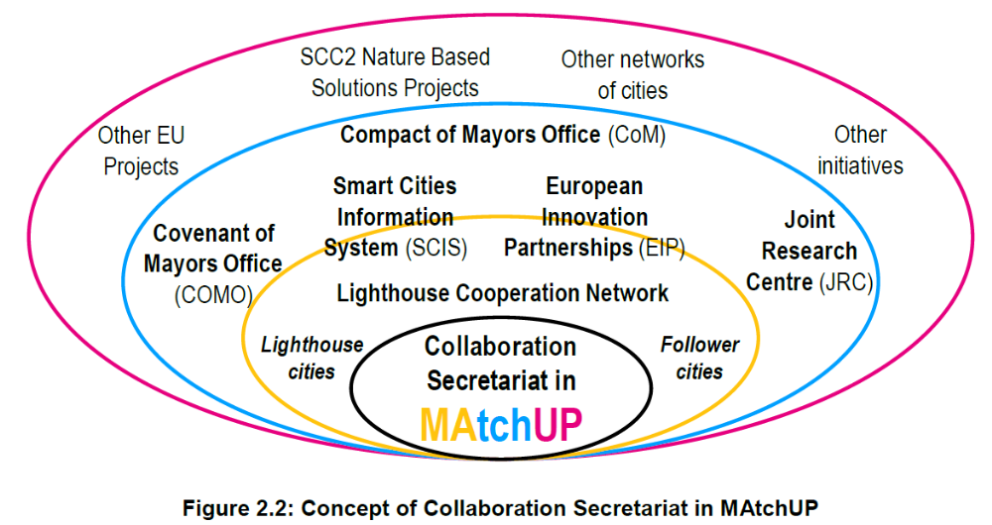

Smart City Collaboration

Slide 12


More information:
@Mayors4Climate
www.globalcovenantofmayors.org

