Slide 1
Final Conference - Panel Discussion
Replicating and scaling-up smart strategies and solutions
Moderator: Eelco Kruizinga

Slide 2
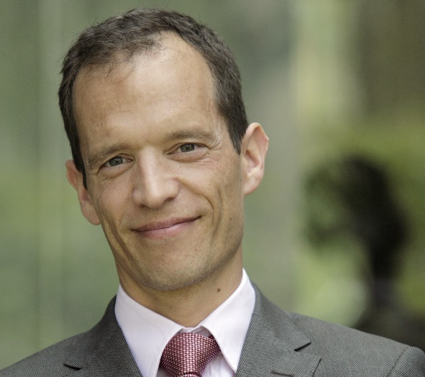
Your moderator?
Eelco Kruizinga, EIP-SCC Marketplace
Matchmaking Specialist
matchmaking@eu-smartcities.eu

Slide 3
Panel debate on replicating and scaling-up smart strategies and solutions (11:30-12:45)
Moderator:
  Eelco Kruizinga | EIP Smart Cities Marketplace Matchmaking Specialist
Briefing on replication and scale-up:
  Albert Engels | Chair - Board of Coordinators Smart City Lighthouse Projects (‘SCC01’)
Panel discussion with:
  Baha Kuban | REMOURBAN
  Nora Mendoza | REPLICATE
  Albert Engels | RUGGEDISED
  Edoardo Croci | MAtchUP
  Luigi d’Oriano | POCITYF

Slide 4
House rules
You are all muted by default to minimise background noise but we are looking forward to your questions!
We will have the Q&A session at the end of the webinar.
You can ask questions either by raising your hand during the Q&A session (and we will allow you to unmute yourself) or anytime by using the chat box on the GoToWebinar control panel.
We will get back to you via email if there are any questions we cannot answer in the course of this session.
Please note: This webinar will be recorded

Slide 5
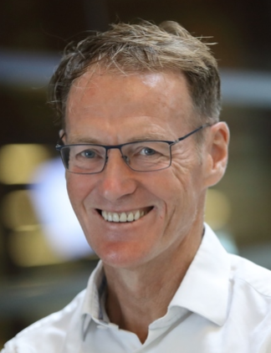
Our scene-setter
Albert Engels, City of Rotterdam
RUGGEDISED
Co-ordinator
on behalf of the 17 European Smart City Lighthouse Projects

Slide 6


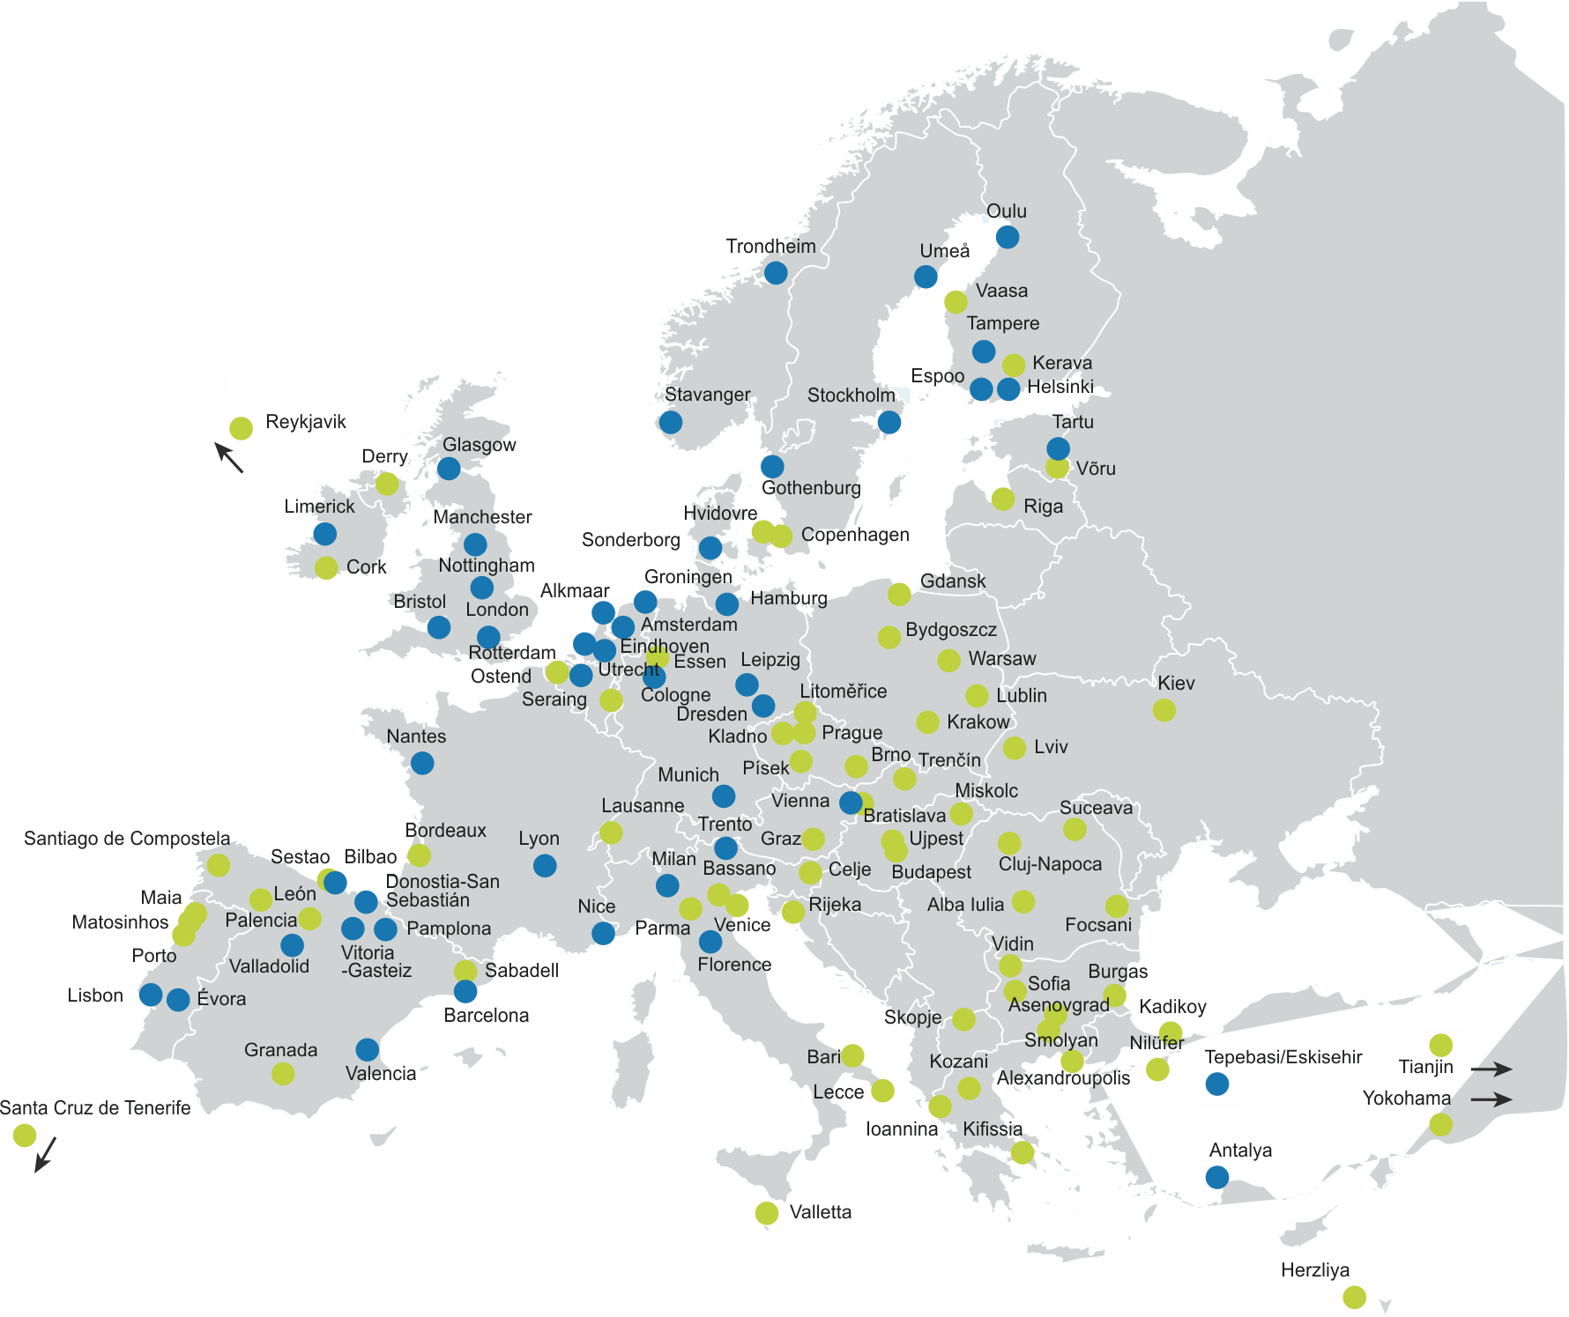







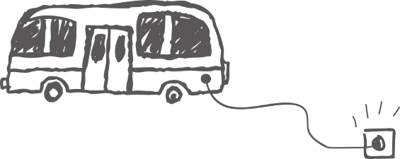












Upscaling and replication in SCC01 Projects
17 smart projects
+100 smart cities
At least 300 smart solutions
Webinar - Name
Date
Notes:
Brief introduction to the SCC01, your role and how the projects are oranised – Fellow to be mentioned in next slide!
I don‘t know the number of solutions, but if all projects have 20 solutions it‘s 340. And Growsmarter had +40 and RUGGEDISED has +30

Slide 7
Upscaling and replication in SCC01 Projects
Replication work in projects
2-6 Fellow Cities per project
  Formerly “Follower” Cities
Replication Work Packages in all projects
Projects work together in SCC01 Replication Task Group
+70 Fellow Cities
Webinar - Name
Date
Notes:
Points worth making: “Formerly follower” is also a chance to discuss how funding for the fellows have increased quite a lot in later projects – due to their importance. It’s

Slide 8













Upscaling and replication in SCC01 Projects
Getting better connected
Webinar - Name
Date
Notes:
Points worth making: “Formerly follower” is also a chance to discuss how funding for the fellows have increased quite a lot in later projects – due to their importance. It’s

Slide 9
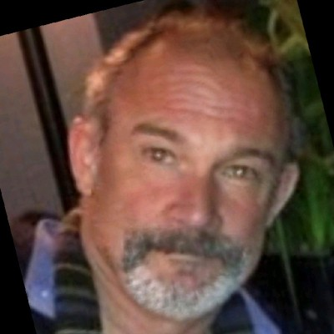
Our panellist
Dr. Baha Kuban is of Demir Enerji, a consulting company specializing in the energy transition, urban climate change mitigation and smart city strategies. Baha works from Istanbul.

Slide 10
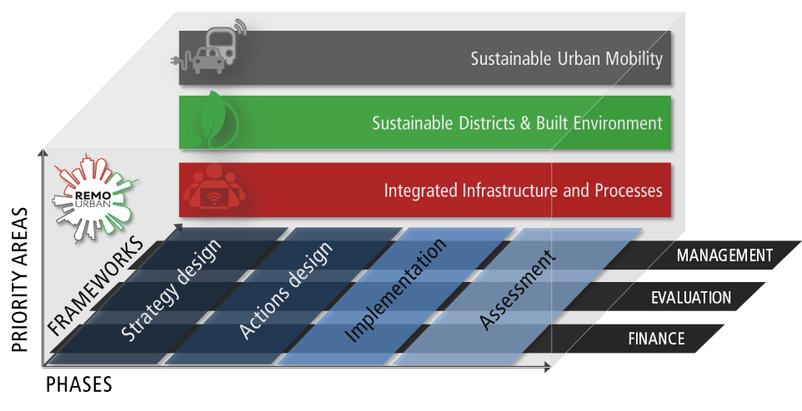






Urban Transitions via the Remourban Urban Regeneration Model URM
REMOURBAN delivers a replicable Urban Regeneration Model through a tested, innovative combination of technologies and methodologies
STRATEGY DESIGN
ACTION DESIGN
IMPLEMENTATION
ASSESSMENT
Data collection
S.C.T.Ps selection
Scenarios generation
Intervention area diagnosis
Monitoring of performance
City Diagnosis
Implementation Plan
Detailed intervention area design
DEMAND
City needs and goals
Scenarios evaluation
Strategic Goals
Evaluation of sustainability and smartness
PROJECT KEY PHASES
Integrated Urban Plan
Scenarios prioritization
Strategy Validation
Action Plan
Procurement and contracting
Execution and Commissioning

Slide 11
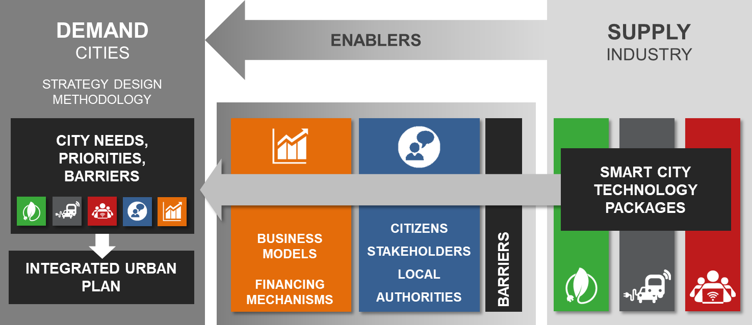
REMOURBAN Replication Model: 3 Elements
SDM
SCTP’s
Strategy Design Methodology: 10-step process supported by REMOURBAN tools, supporting cities with City Strategy based on the identification of needs, priorities and main areas of action.
Smart City Technology Packages: Set of technologies and related operational model (business model, citizen communication strategies, etc.) aimed at capturing information on solutions that stakeholders can deliver.
YOOPi!: Tool that supports cities connecting the information from demand analysis (SDM) with solutions (SCTP’s) considering the local conditions and barriers.

Slide 12
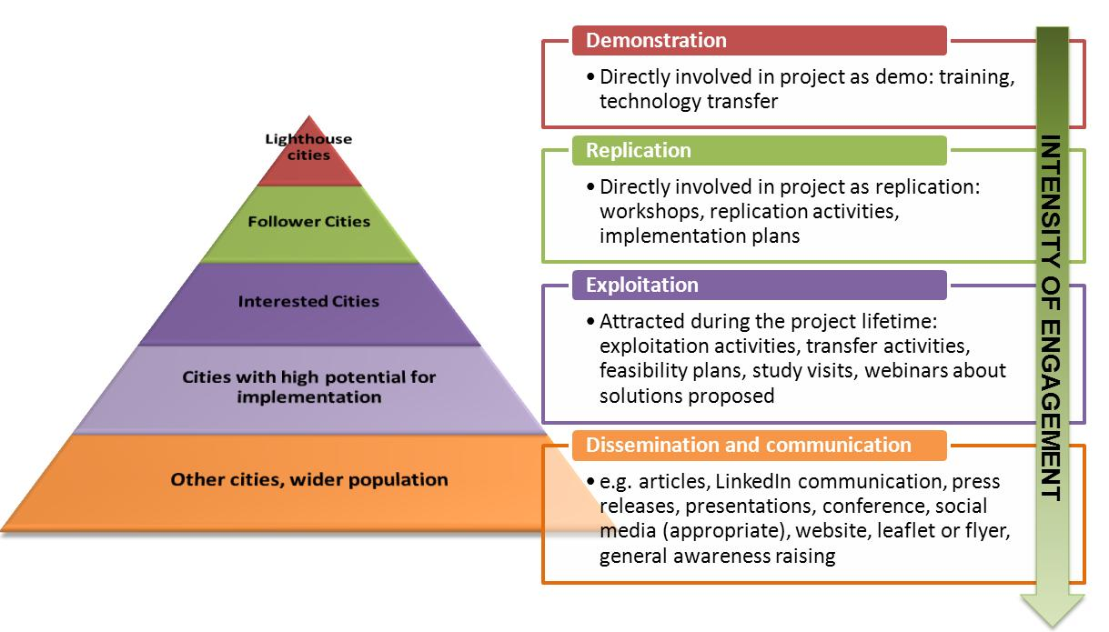
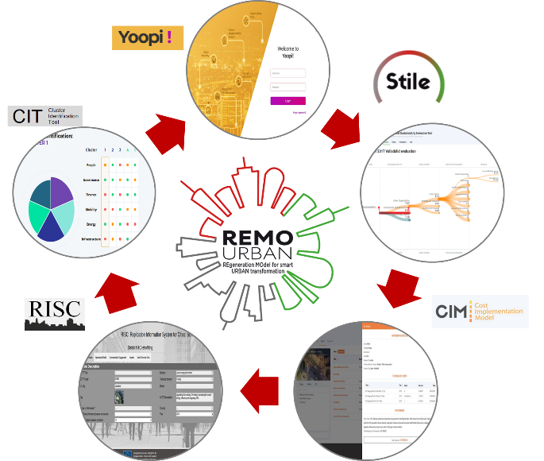
REMOURBAN Replication Model Verification and Tools
Supporting tools of REMOURBAN
Urban Regeneration Model
Lighthouses: Valladolid, Nottingham, Tepebasi
Fellows: Seraing, Miskolc
Outer circle: Oxford, Kadikoy, Segovia

Slide 13
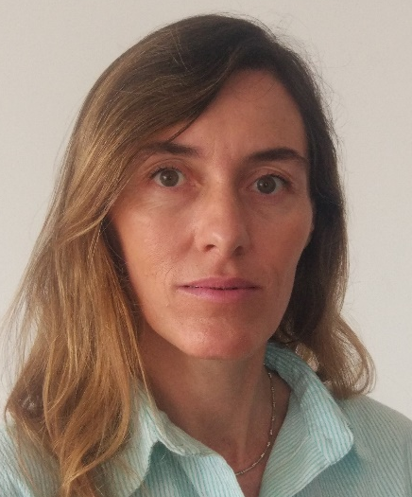

Our panellist
Nora Mendoza of the municipal company Fomento de San Sebastian, in the Basque Country. Specialized on Smart Strategy and Sector Specialization. Replicate coordination team member

Slide 14
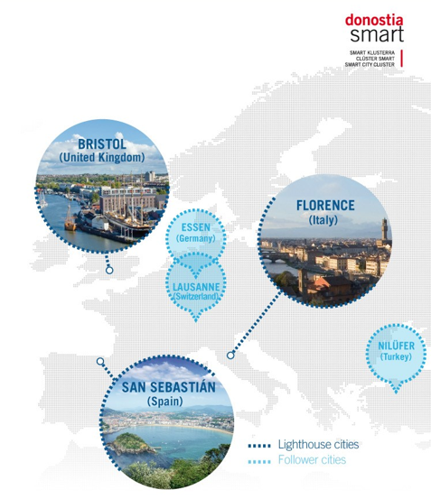
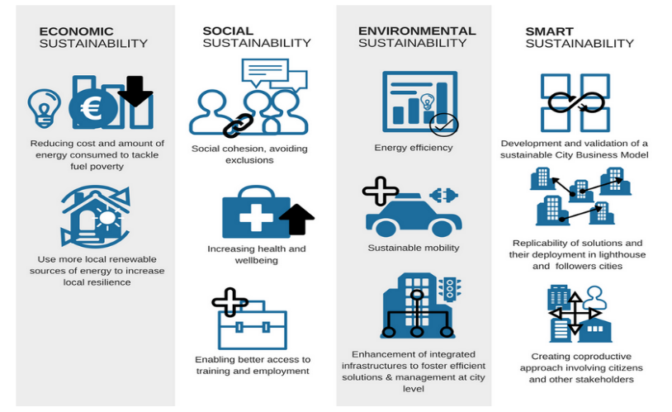
REPLICATE
REPLICATE - REnaissance of PLaces with Innovative Citizenship And Technology
VISION - To increase the quality of life of citizens across Europe by demonstrating the impact of innovative technologies used to co-create Smart City services for citizens and to test the optimal process for replicating successes in cities and across cities
Coordinator – Fomento San Sebastian
39 partners, 7 countries
3 lighthouse cities: San Sebastián, Florence, Bristol
3 fellow cities: Essen, Lausanne, Nilüfer
2 observer cities: Bogota, Guangzhou
6 Academic Institutions
3 Researcher performers
18 Industrial partners
Other companies
5-year project
Y1-Y2-Y3 Implementation
Y4-Y5 Monitoring
Start date: 01/02/2016

Slide 15









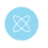
Planning > Implementation > Replication
Smart City Plans (2015)
Donostia / San Sebastian, Florence and Bristol have collaborated before up to 2015 in the project STEEP-Systems Thinking for Comprehensive City Efficient Energy Planning
Lighthouse Cities implementations (02/2016-02/2021)
Comprehensive strategy for smart districts
Improvement of the transition to smart city:
Energy efficiency
  Building retrofitting
  District Heating System
  Smart Grid and Demand Side Platform
Sustainable mobility
  Acquisition/Monitoring of EV Cars, e-motos, e-buses, e-taxis, e-bikes
  Advanced Charging Infrastructure
  Transport Management Services for Citizens
“Development and validation of a comprehensive and sustainable City Business Model to enhance the transition process to a smart city to be replicated in other towns and districts”
ICT & infrastructure
  Smart City Platform integrating current Local IT System
  Open data, Link Open Data and Citizen Participation services
  Deployment of services and sensors
  High Speed Wireless Mobile Network Deployment
  Public Smart Lighting deployment
Cross-cutting activities
  Strategic Planning, Business Models and Exploitation
  Replication and scale-up
  Monitoring
ENGAGEMENT

Slide 16
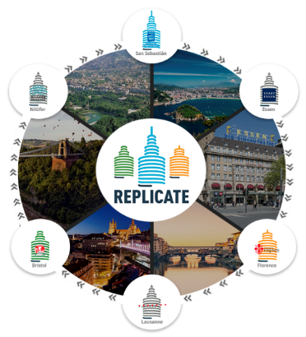
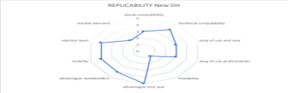
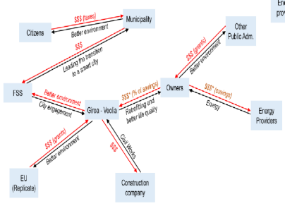

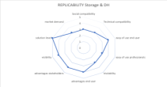
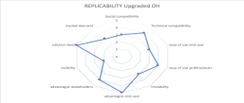
Planning > Implementation > Replication
Replication plans in LCs - Scale up (2020-2030/2050)
Replication plans in FC
Results analysis (technical&management), exchanges, optimal conditions for extensión – benchlearning among cities:
Temporal & spacial horizon definition (link to policy and vision)
Framework evaluation (legislation, regulation, financial instruments)
Stakeholders engagement
Assessment and validation of impacts (monitoring) and business models
OXFORD University
Monitoring-Tecnalia
Value Cration Ecosystem – ESADE Business school
Smart & Sustaiable City Model – SPES

Slide 17
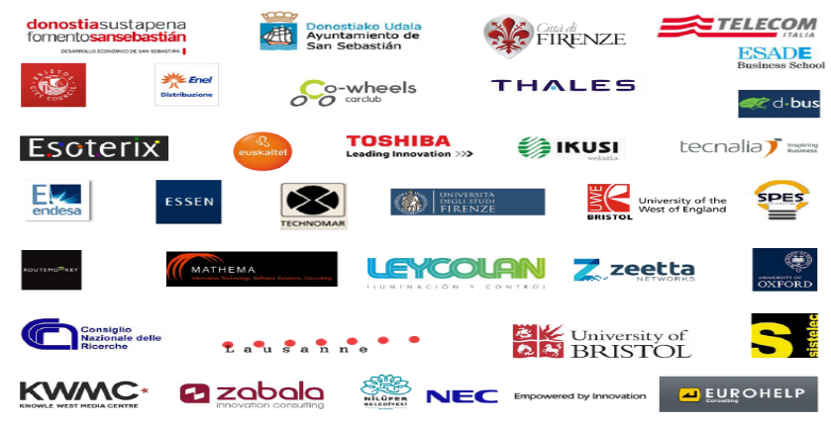
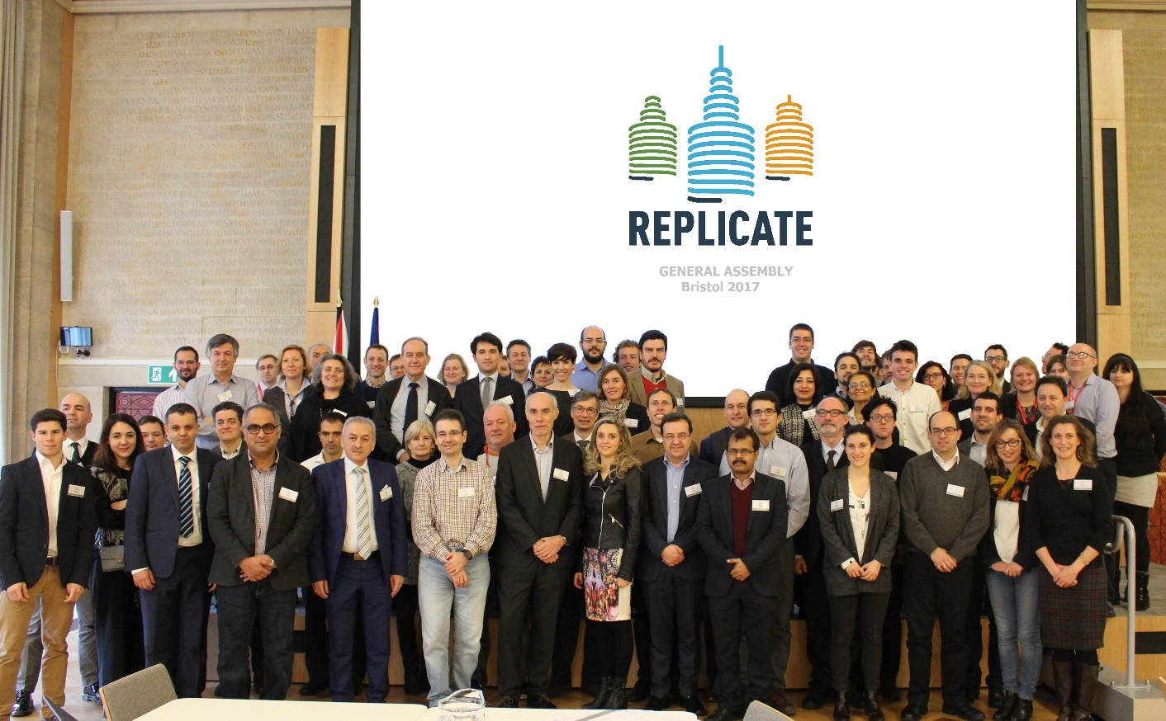


Thank you for your attention
REPLICATE TEAM
https://replicate-project.eu/

Slide 18
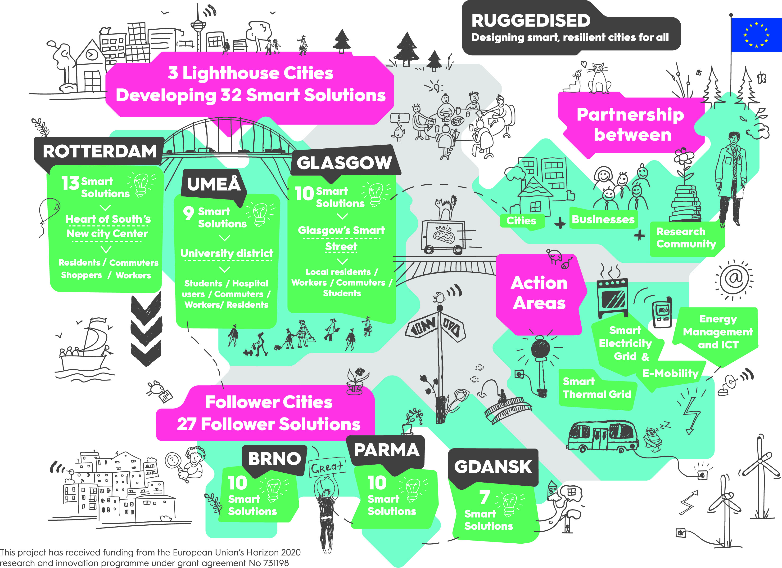

RUGGEDISED INTRODUCTION
Insert your project logo here

Slide 19
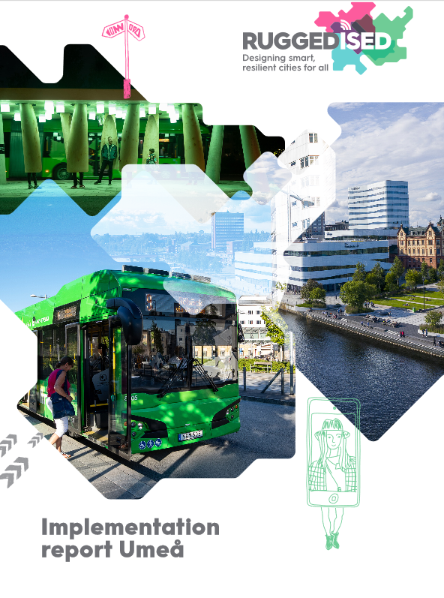
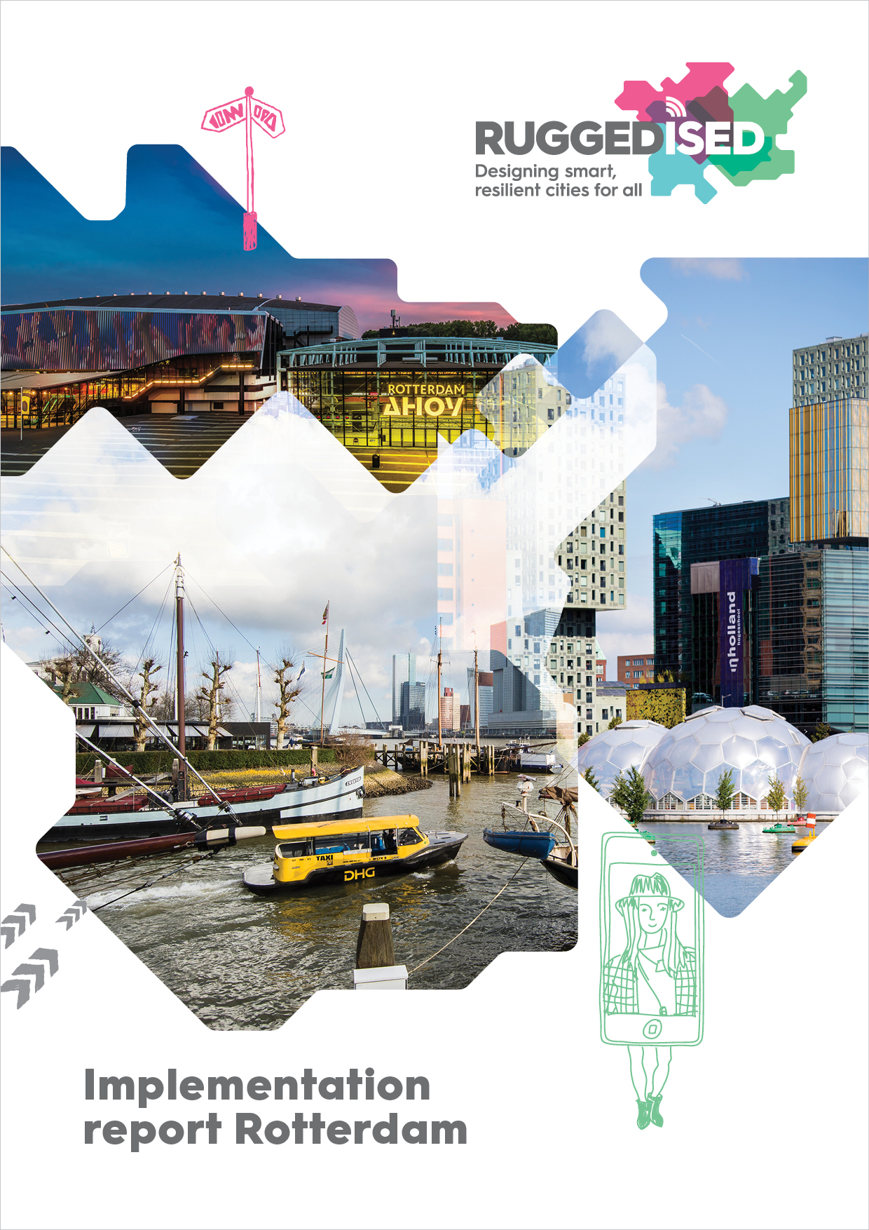
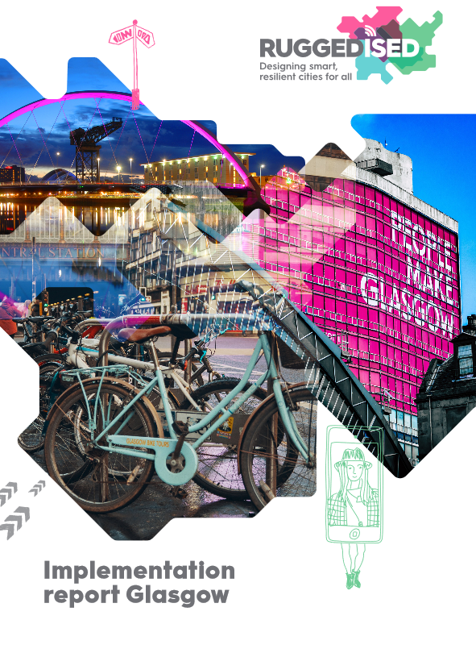

IMPLEMENTATION
Insert your project logo here

Slide 20
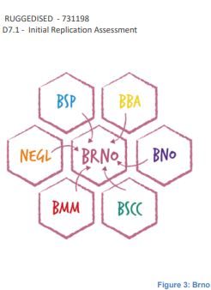
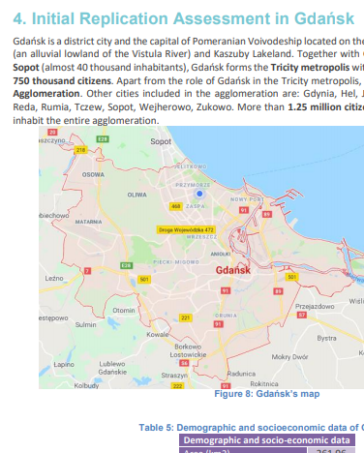
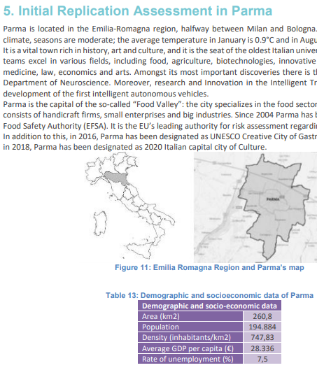
UPSCALING & REPLICATION
Brno
Gdansk
Parma
Insert your project logo here

Slide 21
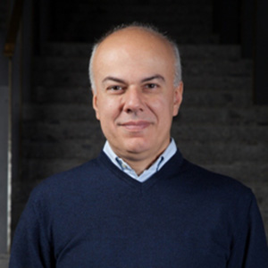
Our panellist
Edoardo Croci, Senior Research Fellow at GREEN (Centre for Geography, Resources, Environment, Energy and Networks) at Bocconi University in Milan.
Edoardo is WP leader on exploitation and market deployment - innovative business models of MAtchUP project

Slide 22
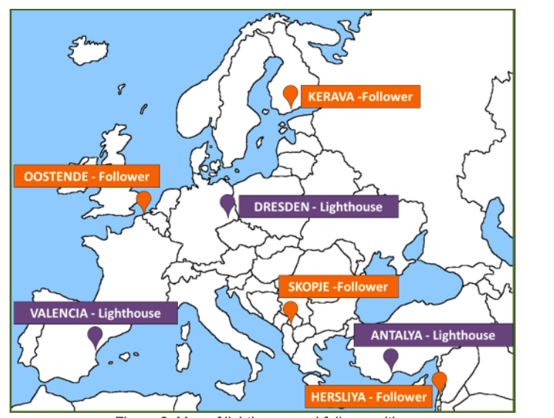


MAtchUP MAximizing the UPscaling and replication potential of high level urban transformation strategies
Duration: 60 months (November 2017 – September 2022)
Project Coordinator: Valencia Municipality (Spain)
Consortium: 28 partners from 8 countries (Spain, Germany, Turkey, Israel, FYROM, Belgium, Finland, Italy)
MAtchUP is a lighthouse cities project and it addresses the issues that constrains a wider development of the urban transformation of the cities through the use of innovative technologies in energy, mobility and ICT areas and through the direct engagement of citizens.
MAtchUP applies a methodology to reach high impact and consolidate wide replication, using relevant urban planning mechanisms and paying special attention to the transferability of business models.
https://www.matchup-project.eu/
This project has received funding from the European Union’s Horizon 2020 research and innovation programme under grant agreement No 774477

Slide 23
Business model characterization to support transferability
A business model defines how smart city solutions “create, deliver and capture value”, meaning not only its financial performance (private value) but also its wider social, economic and environmental (public) value.
  In MAtchUP, business models are analysed at “action bundle” level rather than at individual solution level. Bundles are groupings of actions that are interlinked among them from a financing point of view, and/or that are jointly able to generate costs and revenues.
  The aim of this approach is to identify the economies of scope in these groupings, which can derive from synergies in the joint design/implementation/monitoring of smart solutions, as well as the economies of scale deriving from the up-scaling of single solutions to other parts of the city.
Business model
Financial model
Cost structure
Social acceptance
Actors involved
Market acceptance

Slide 24
Benefits of smart city solutions and related business models
Smart city solutions can also deliver wider positive externalities, which are not always taken into account and monetized into the business model. These may include, among others:
improvement in city services
increased efficiency in governance
improvement of environmental conditions (e.g. air pollution reduction, GHG emissions reduction)
energy and cost-savings
time savings
increase of safety
health benefits
innovation in the industry sector and in economic activities
promotion of new economic activities/business models
smarter infrastructure.
Through a questionnaire survey targeted to lighthouse cities and technical partners, MAtchUP evaluated the relevance of benefits from different smart city action bundles in the four project pillars (energy, mobility, ICT, non-technical actions).

Slide 25
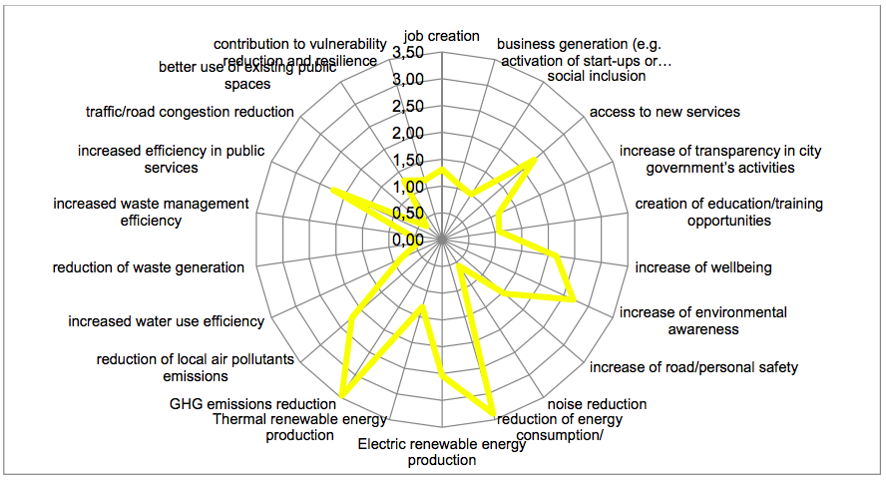
Rating of benefits’ relevance - energy action bundles
Rating scale:
0 - not relevant
4 - highly relevant
Source: MAtchUP project (2020)

Slide 26
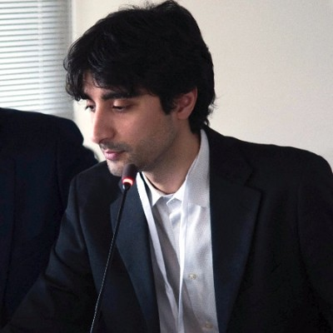
Our panellist
Luigi d’Oriano, H2020 Project and Proposal Manager. POCITYF Replication Manager

Slide 27

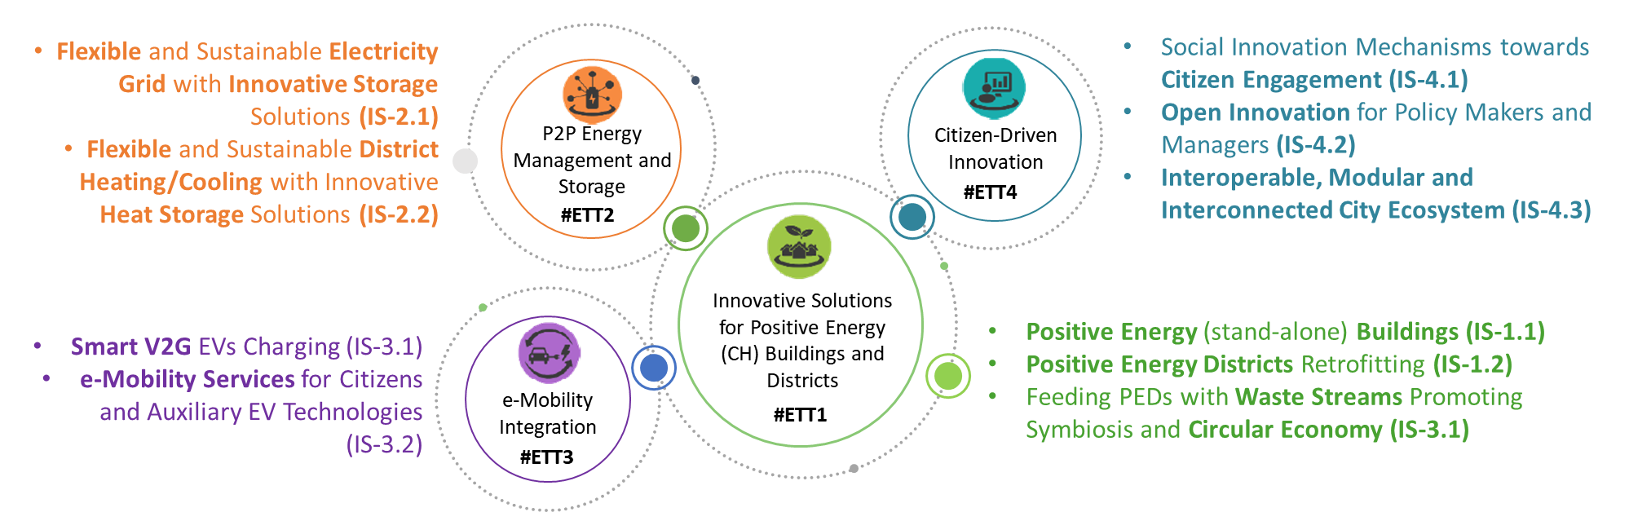

Pocityf has two main goals…
To add layers of smartness in key city infrastructures, delivering Positive Energy Blocks with focus on cultural heritage areas
Develop and deploy citizen-centred integrated and multidisciplinary solutions, intervening at technological, political, social, urbanistic and economic level
Reflected in 10 Integrated Solutions

Slide 28
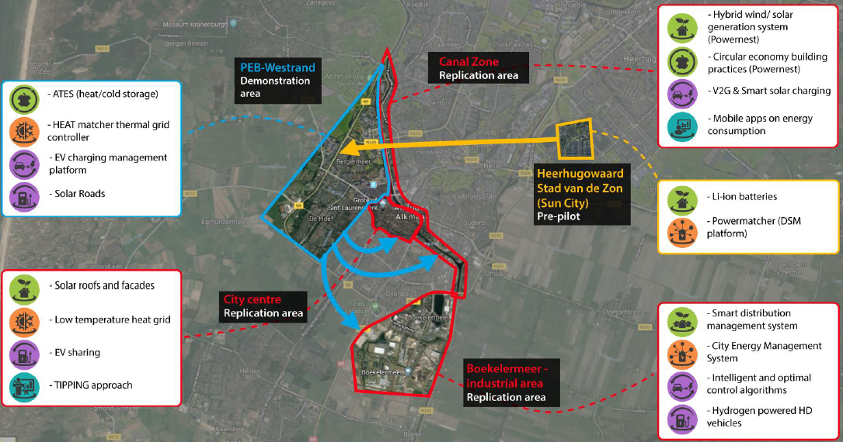
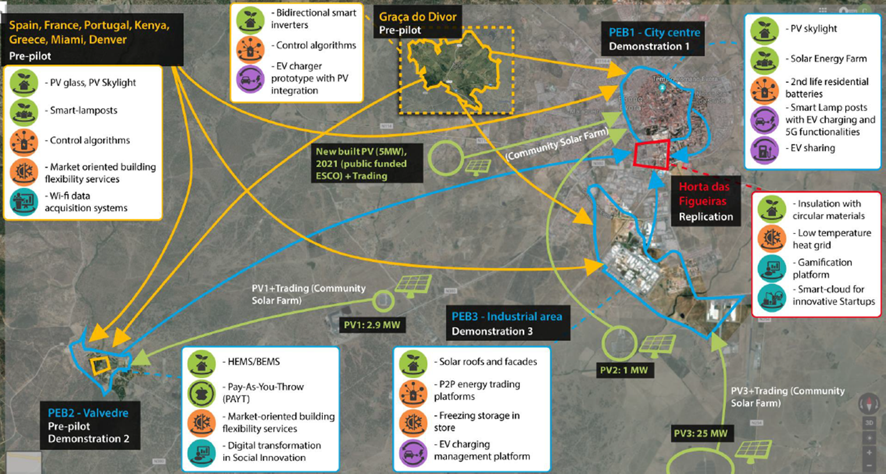

The three tier Replication concept
T1. Scaling-up and Replication on Lighthouse cities
Notes:
We are working towards the possity to replicate something on LH within 5y Project

Slide 29
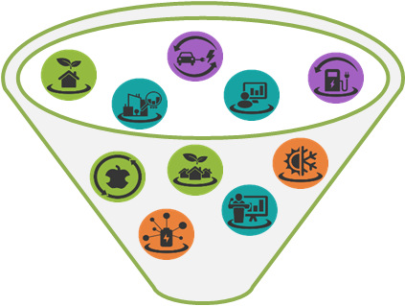




The three tier Replication concept
T2. Replication on FCs
Derived from POCITYF and underlying investment, LHCs and FC expect to attract €1bn for the period 2025-2029
FCs (tons CO2 eq/year reduction)
Granada: 7.070
Bari: 2.500 & 6.400
Celje: 4.500 & 2.580
Ujpest: 2.121
Ioannina: 1.300
Hvidovre: 448
21 building complexes
4 PEBs
17.500 residents
87.480 m²
13,25 GWh/year
18 historical buildings
1400.000 m²
Pre-POCITYF
Throughout POCITYF

Slide 30
The three tier Replication concept
T3. Replication on cities outside POCITYF
A Key element is the capability to exploit POCITYF technology solutions (still too early to make forecasts)
Modular exploitable offer on the market
EURADA enables the linkage with the EU Regional Development Agencies
LoS / AB signatories as driver for replicating Pocityf in EU
Public / Public-private funding schemes can drive a wider replication
Notes:
Modular: Replication as market rollout will differs by technology, according to the maturity of each, and to the barriers/drivers encountered.
EURADA: BRIDGE TO REGIONAL ECOSYSTEMS
PPP: ELENA or innovation funds can drive a wider replication

Slide 31

Thank you!
Luigi D’Oriano
POCITYF Replication Manager
luigi.doriano@energyatwork.it
Notes:
Modular: Replication as market rollout will differs by technology, according to the maturity of each, and to the barriers/drivers encountered.
EURADA: BRIDGE TO REGIONAL ECOSYSTEMS
PPP: ELENA or innovation funds can drive a wider replication

