Slide 1



the co-logic of resilient cities
Bruno Sauer
CEO, Green Building Council España
www.gbce.es

Slide 2

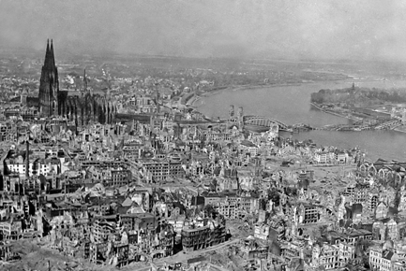
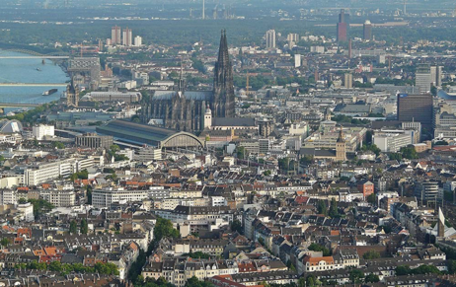
1945 vs 2020
Cologne

Slide 3
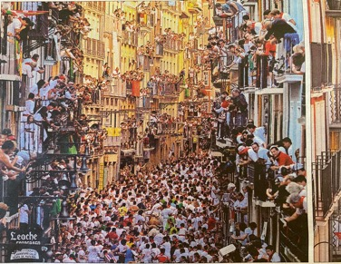
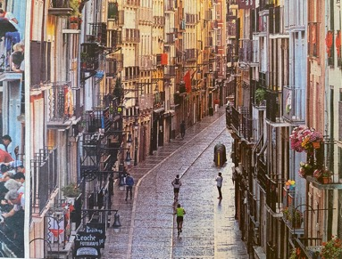
2013 vs 2020
Pamplona

Slide 4
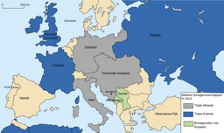
The 19th C finished in 1914 because of a political powerplay.

Slide 5
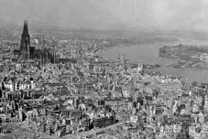
The 19th C finished in 1914 because of a political crisis.
The 20th C started in 1945 with a global destruction of cities and economy.

Slide 6

The 19th C finished in 1914 because of a political crisis.
The 20th C started in 1945 with a global destruction of cities and economy.
The 20th C finished in 2015 with a global agreement on a new model of development, the SDGs.

Slide 7

The 19th C finished in 1914 because of a political crisis.
The 20th C started in 1945 with a global destruction of cities and economy.
The 20th C finished in 2015 with a global agreement on a new model of development, the SDGs.
The 21th C started in 2020 with a global destruction of the (individual) human confort zone: Covid.

Slide 8
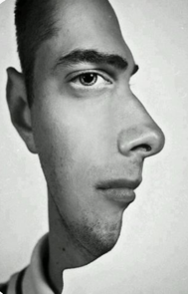
The main challenge of the 21st C is not technological but HUMAN.

Slide 9
The main challenge of the 21st C is not technological but HUMAN.
How can we create a new model of society that counts in the first place on the Human Behaviour to be resilient in a changing future?

Slide 10
What influences the human behaviour?
Social environment
Emotions and associations
Physical environment
Self-image
Personal capacities
Habits and automatisms
Attitude
Intention
Knowledge

Slide 11
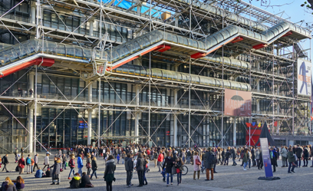
What influences the human behaviour?
Social environment
Emotions and associations
Physical environment
Self-image
Personal capacities
Habits and automatisms
Attitude
Intention
Knowledge

Slide 12
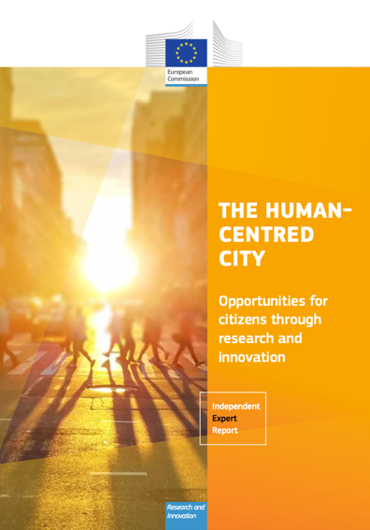
Dear citizen…how much space do we have available to transform your city?

Slide 13
Urban Space as a Scarce Resource
The co-logic design model is based on three principles:
Focus on common ground.
Colourfull decision making.
Local truth above global uniformity.

Slide 14
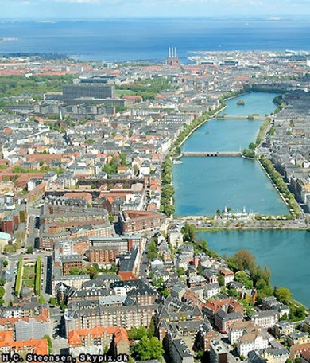
Challenges for a resilient city ?

Slide 15
Challenges for a resilient city
Decarbonization
Adaptability
Heat stress reduction
Flood management
Density
Public-Private Property
Health and well-being
Biodiversity
Mobility
Local economical complexity

Slide 16
KPQ (key principal question)
What kind of spaces* can we transform to give the citizens a physical environment that makes it easier to change their behaviour* to have success in the transformation* of the city?
*space = new scarce resource
*change in behaviour = 18th SDG
*transformation = main activity

Slide 17
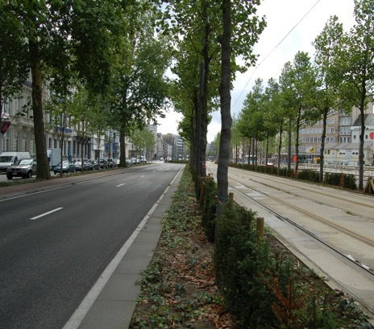
Streets
Decarbonization
Adaptability
Heat stress reduction
Flood management
Density
Public-Private Property
Health and well-being
Biodiversity
Mobility
Local economical complexity

Slide 18
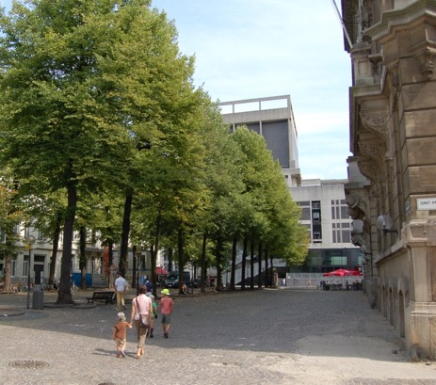
Squares
Decarbonization
Adaptability
Heat stress reduction
Flood management
Density
Public-Private Property
Health and well-being
Biodiversity
Mobility
Local economical complexity

Slide 19
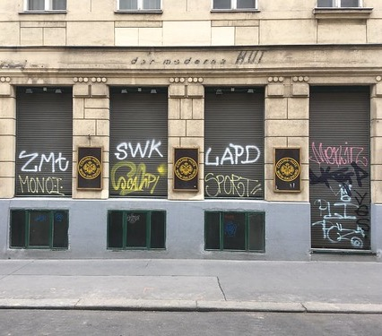
Ground floor
Decarbonization
Adaptability
Heat stress reduction
Flood management
Density
Public-Private Property
Health and well-being
Biodiversity
Mobility
Local economical complexity

Slide 20
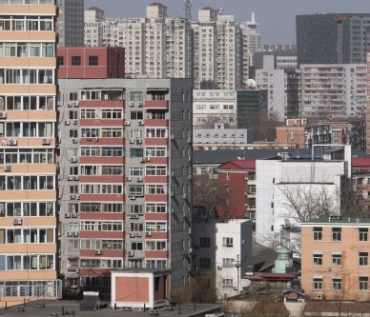
Housing
Decarbonization
Adaptability
Heat stress reduction
Flood management
Density
Public-Private Property
Health and well-being
Biodiversity
Mobility
Local economical complexity

Slide 21
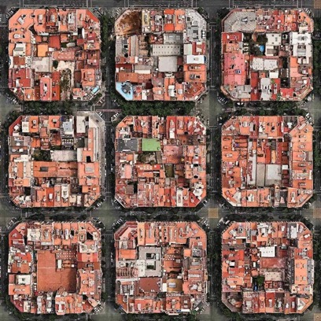
City Block
Decarbonization
Adaptability
Heat stress reduction
Flood management
Density
Public-Private Property
Health and well-being
Biodiversity
Mobility
Local economical complexity

Slide 22
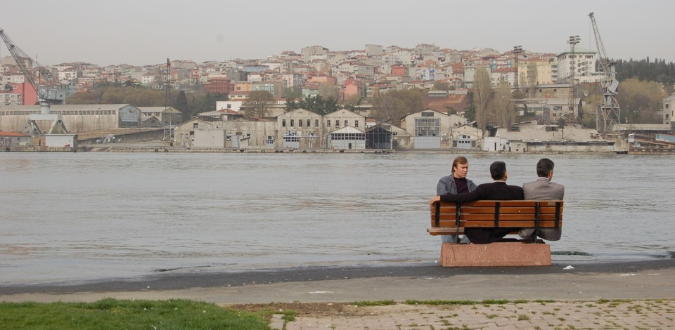

Slide 23
Thank you.
Bruno Sauer
CEO, Green Building Council España
www.gbce.es

