Slide 1
CARTIF
Cristina de Torre
Project Coordinator
CONCLUSIONS & TAKEAWAYS
3rd FINAL CONFERENCE

Slide 2
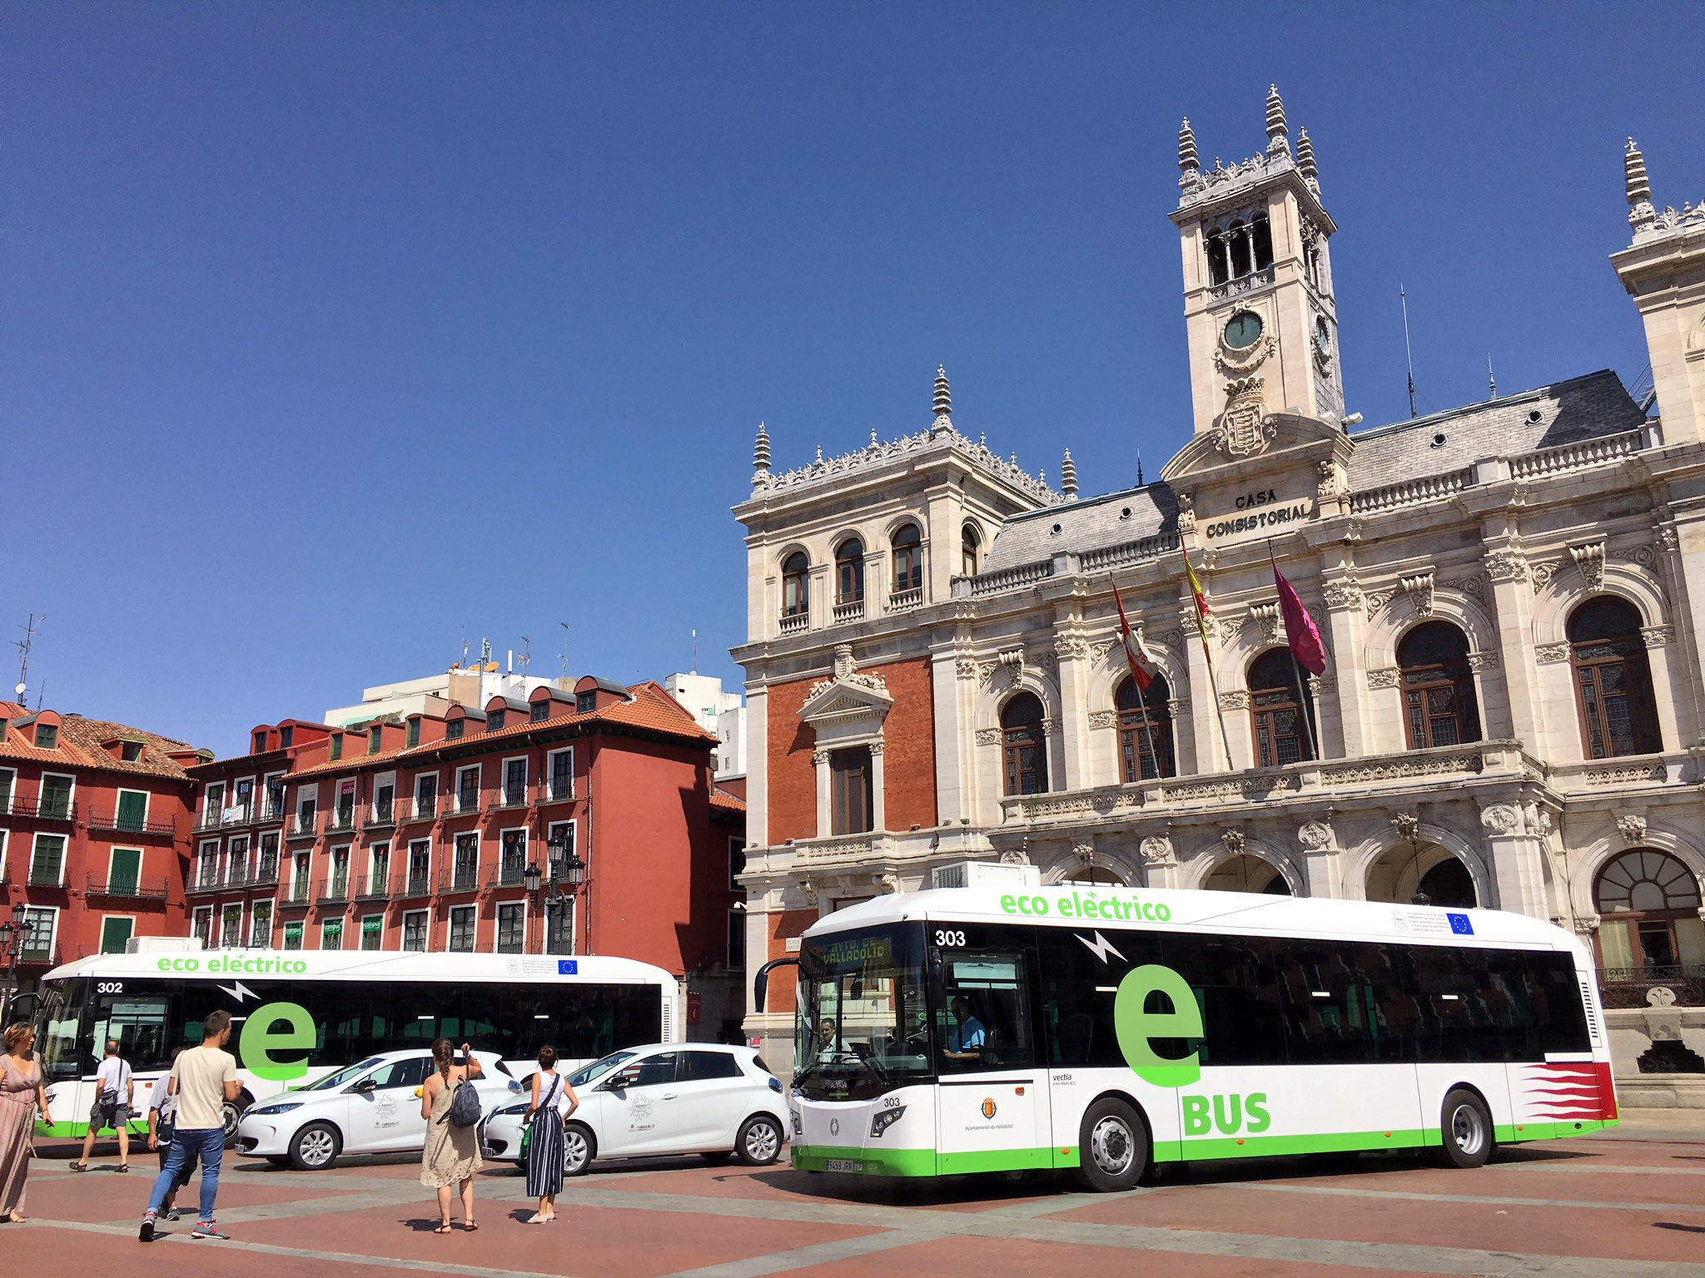
our goal was providing a model to make cities
smarter
and more sustainable
Valladolid

Slide 3
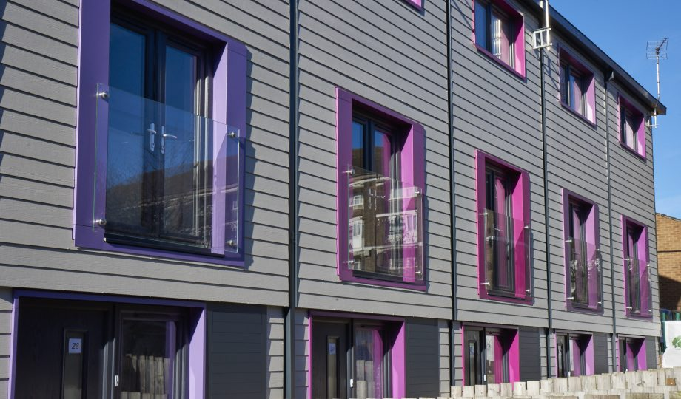
An Urban Regeneration Model,
replicable and holistic,
has been defined
Nottingham

Slide 4
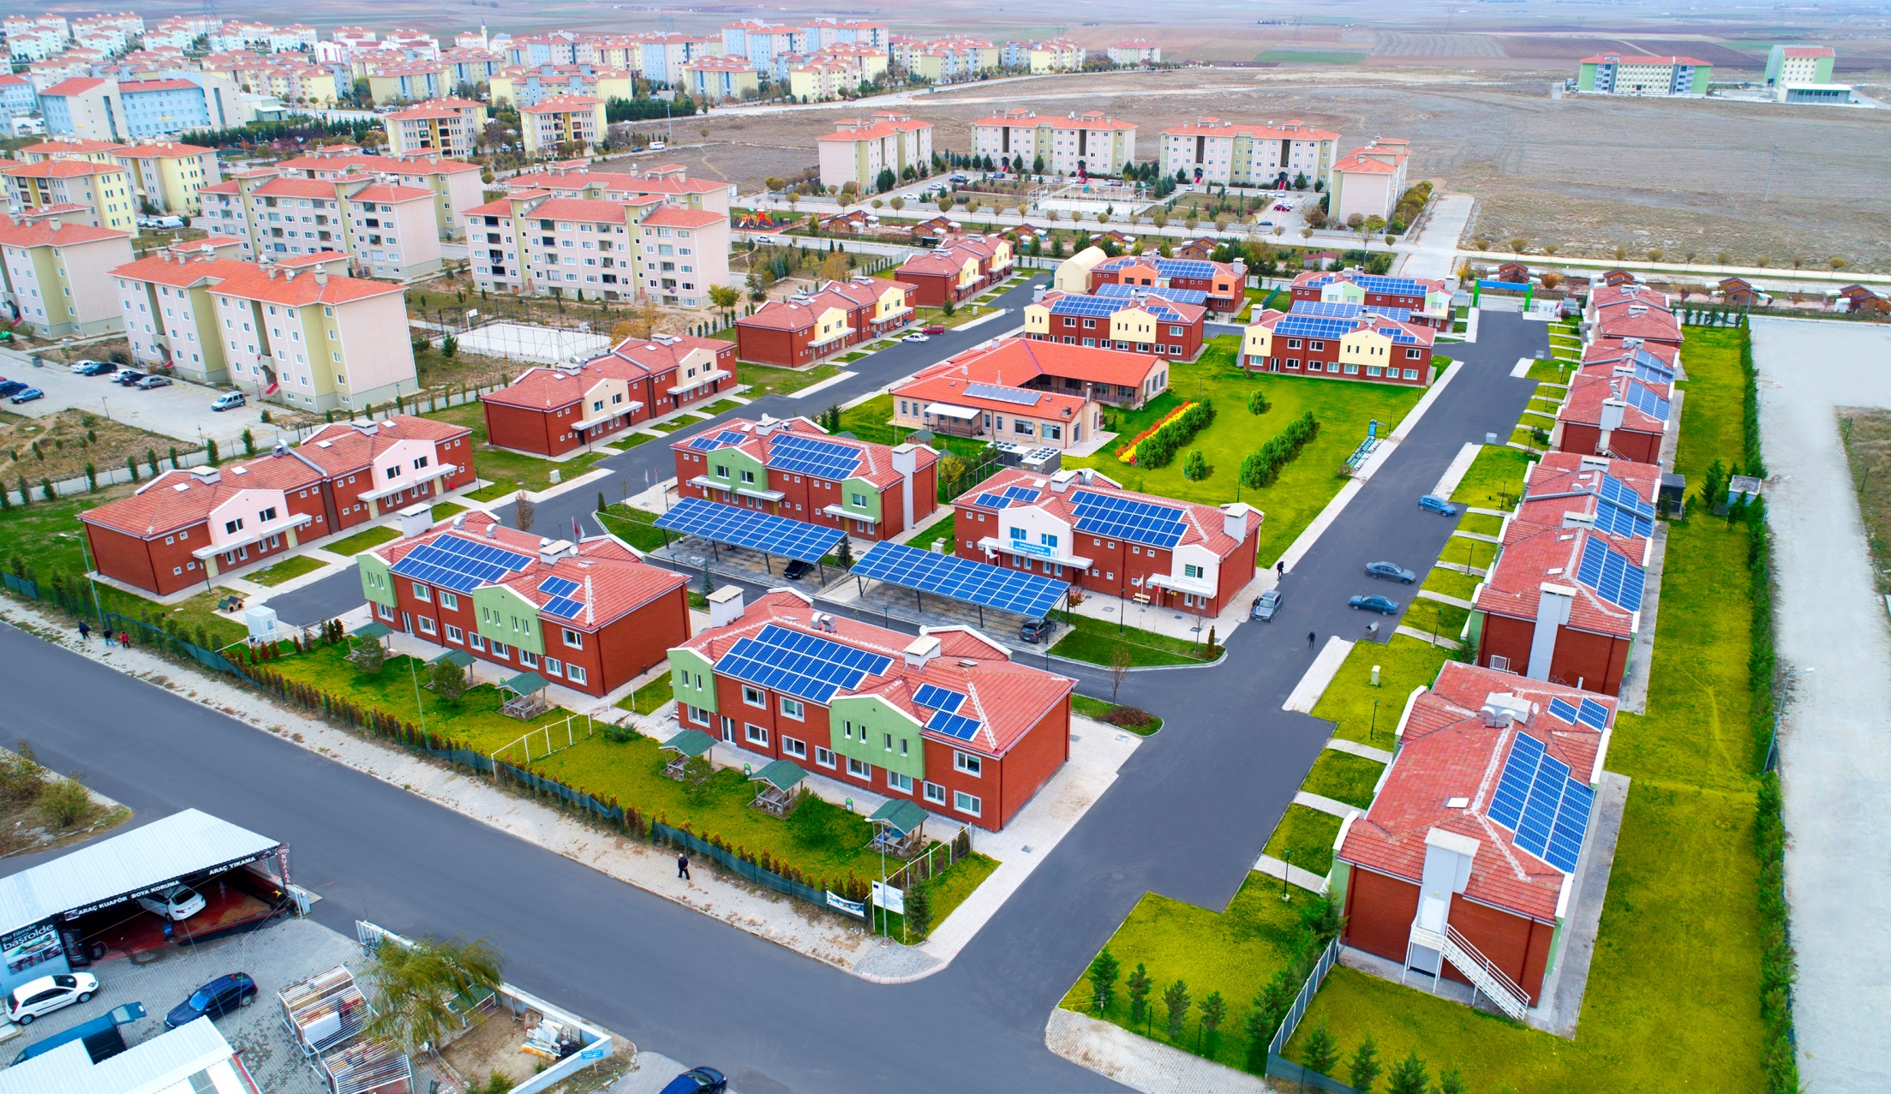
It has been
deployed in the Lighthouse Cities
Tepebaşı

Slide 5
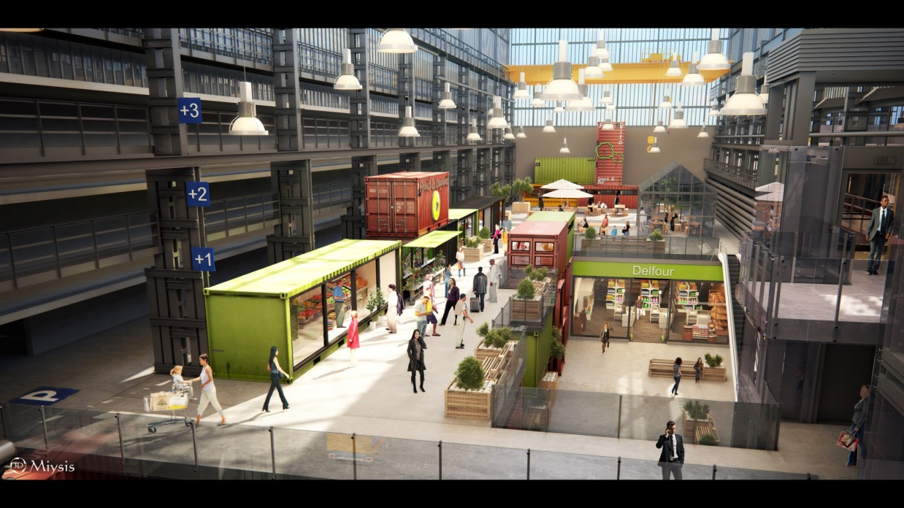
And tested
in the Follower cities:
REPLICATION PLANS
Seraing

Slide 6
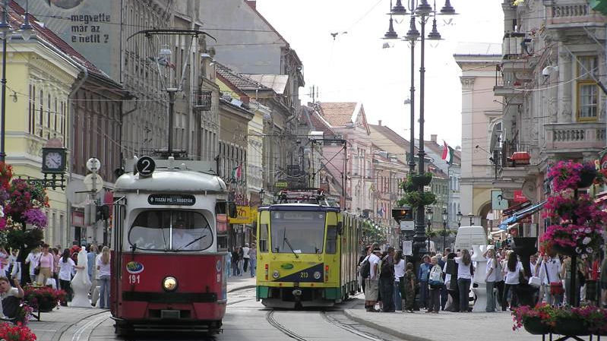
REMOURBAN cities:
INTEGRATED URBAN PLANS
By Birincsik József - Birincsik József saját munkája, CC BY 2.5, https://commons.wikimedia.org/w/index.php?curid=208287
Miskolc

Slide 7
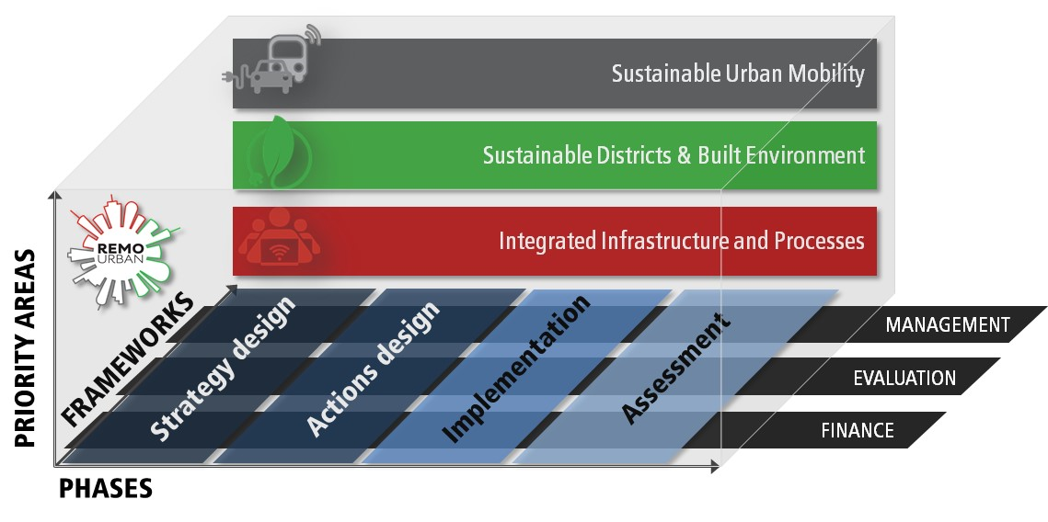
Urban Regeneration Model

Slide 8
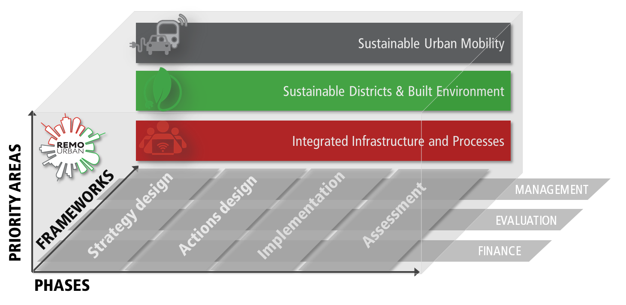
Urban Regeneration Model

Slide 9
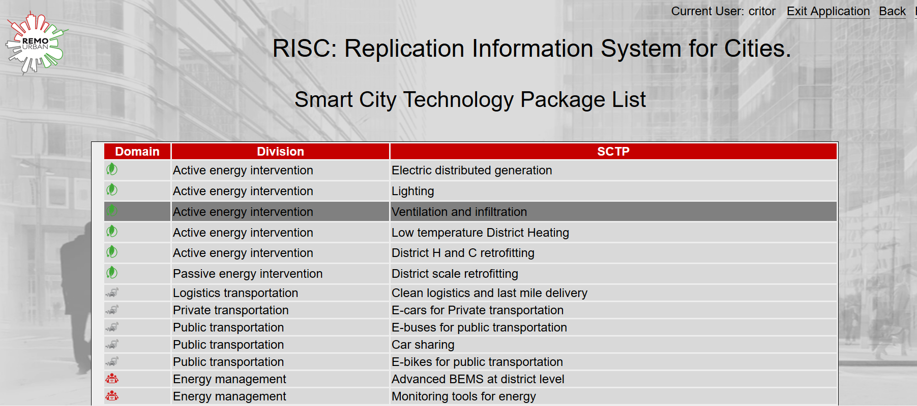

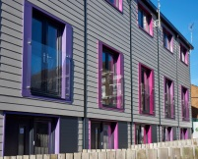
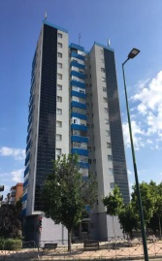
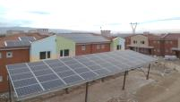
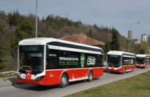
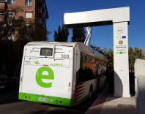


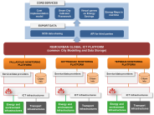
RISC: Replication Information System for Cities

Slide 10
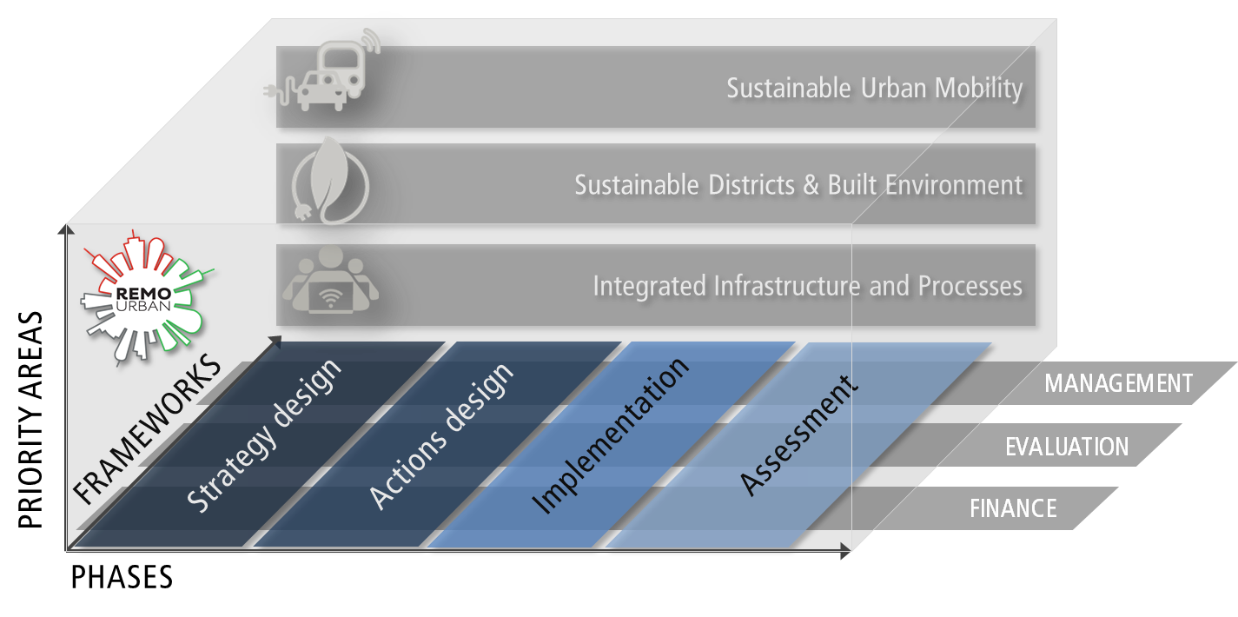
Urban Regeneration Model

Slide 11
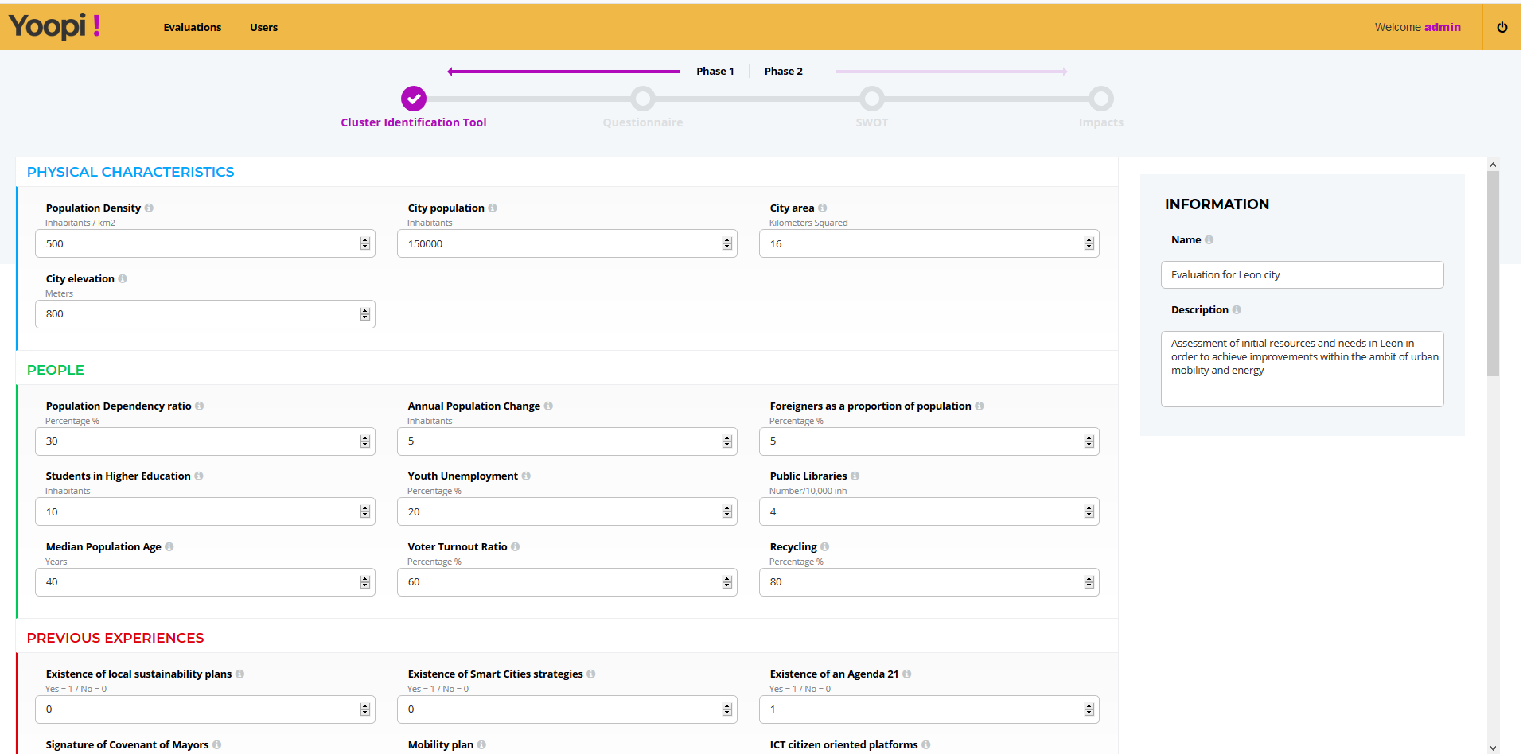
Cluster Identification Tool

Slide 12
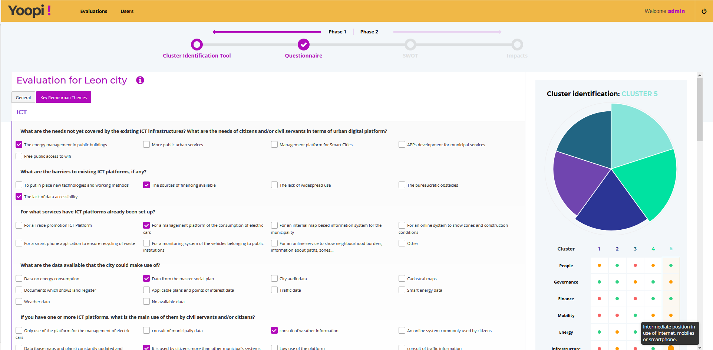
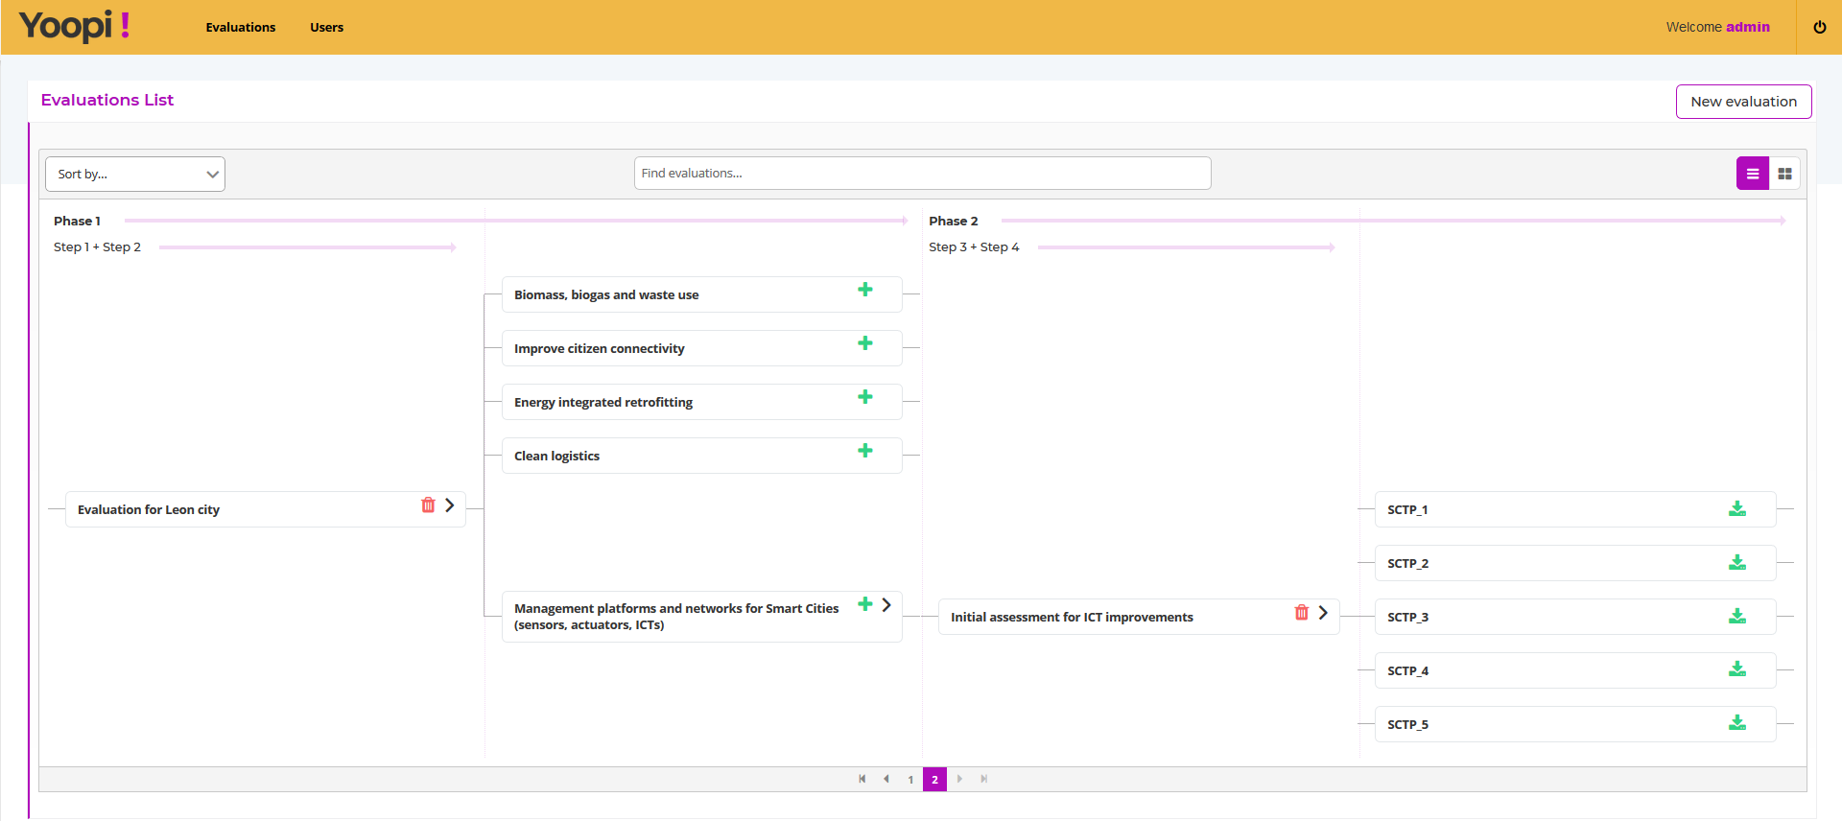
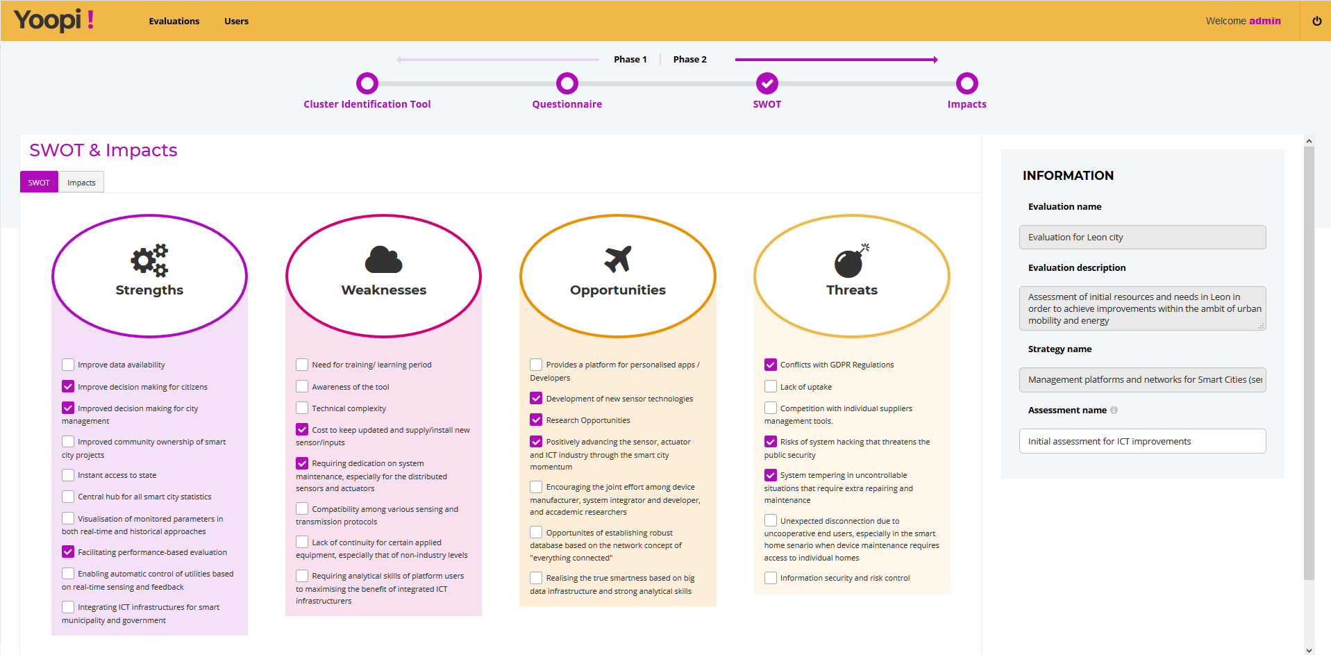
Yoopi! Tool

Slide 13
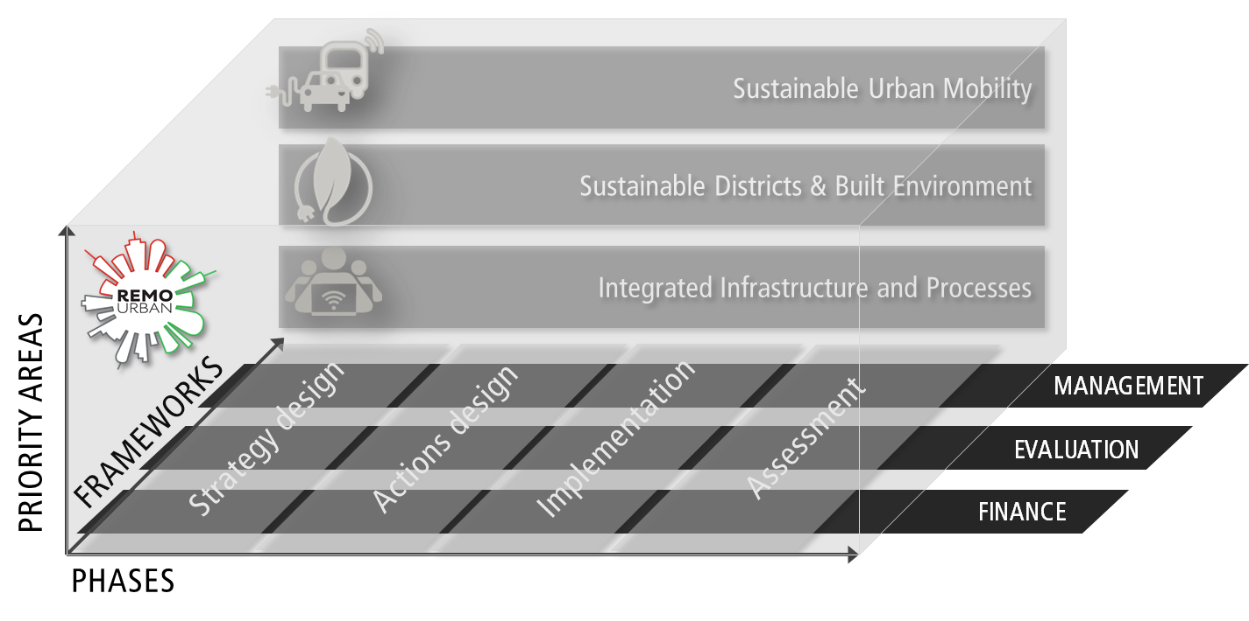
Urban Regeneration Model

Slide 14
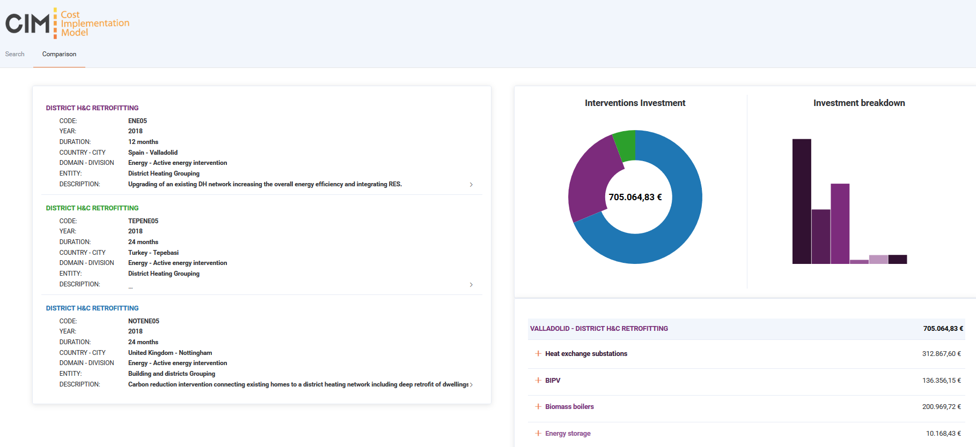
Cost Implementation Model

Slide 15
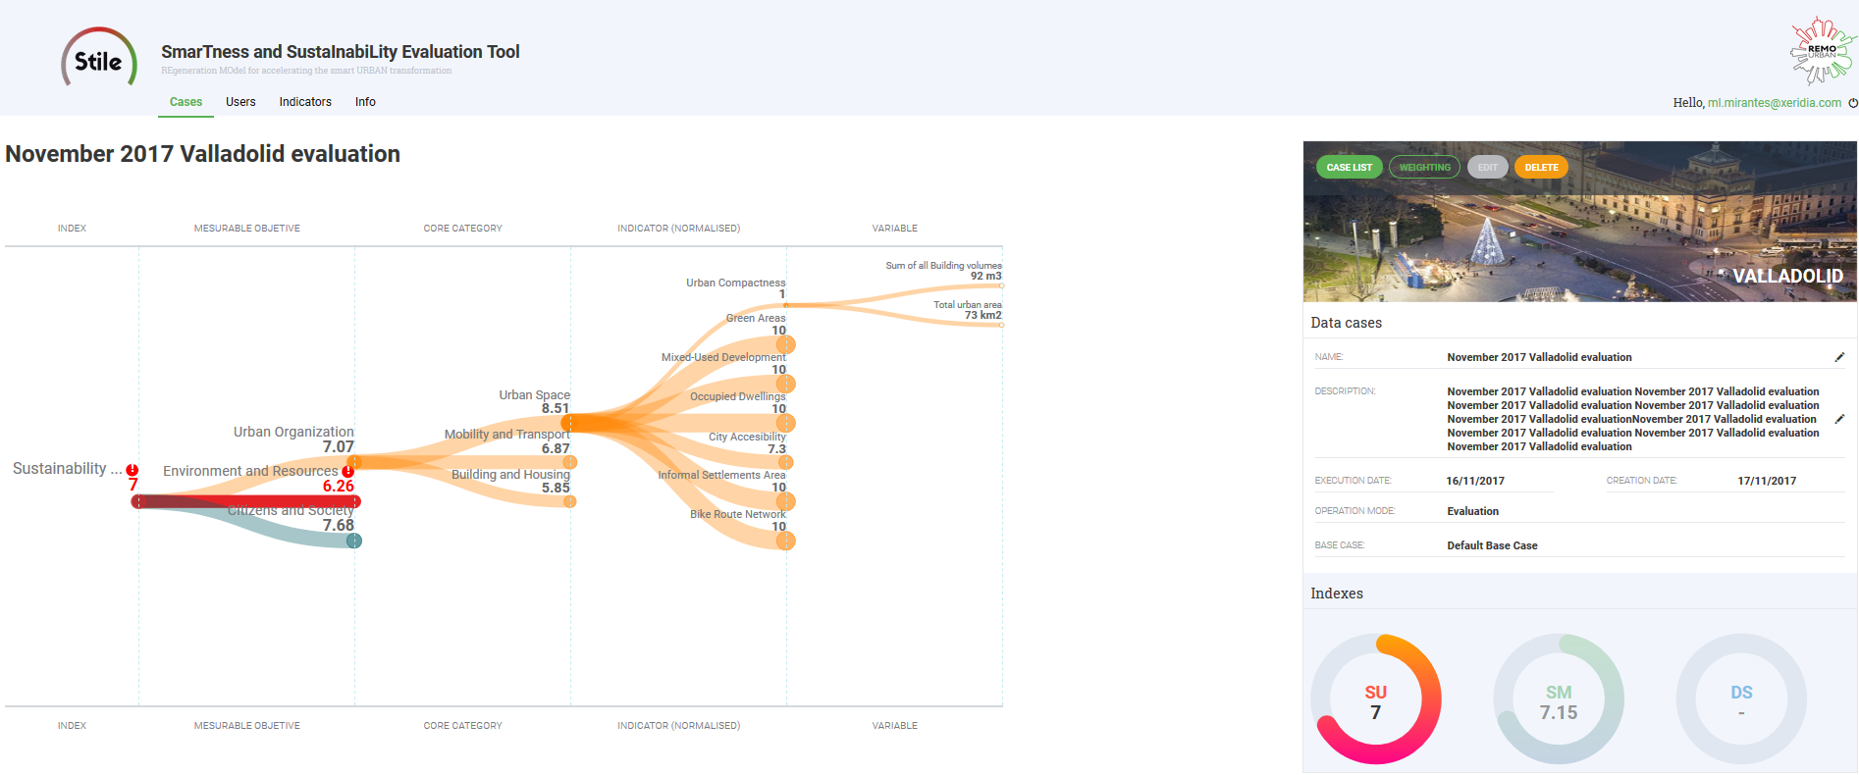
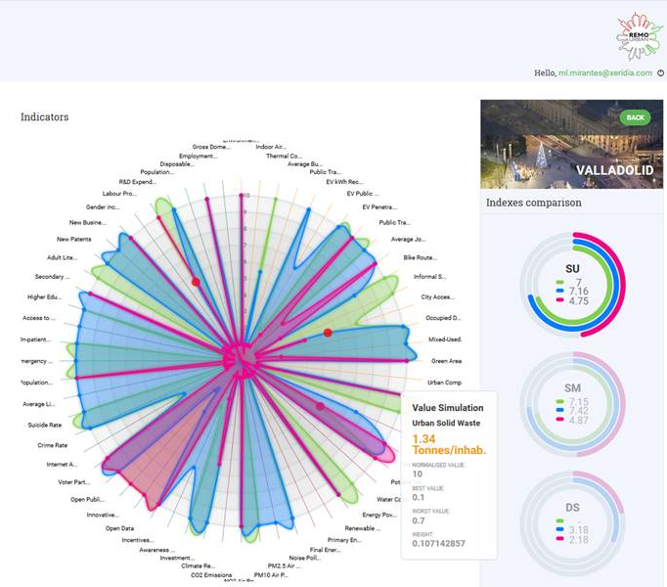
STILE: SmarTness and SustaInabiLity Evaluation Tool

Slide 16






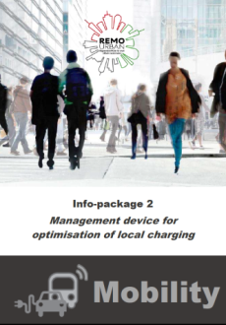

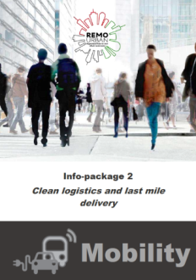


Infopacks

Slide 17

Exploitation Booklet
REMOURBAN Exploitable Results
Urban Regeneration Model
Low Temperature District Heating Model
ICT Platform

Slide 18


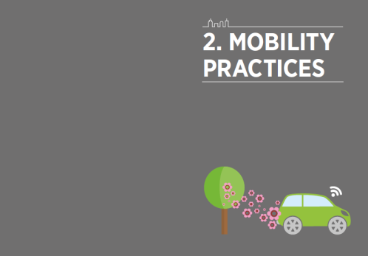
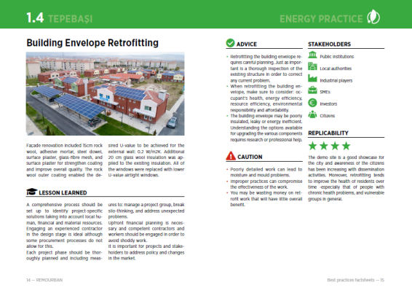
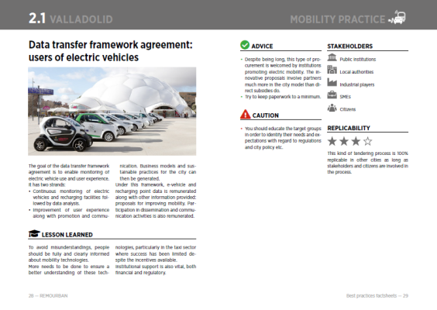


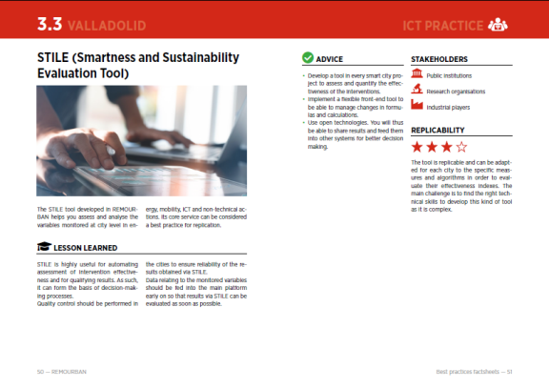
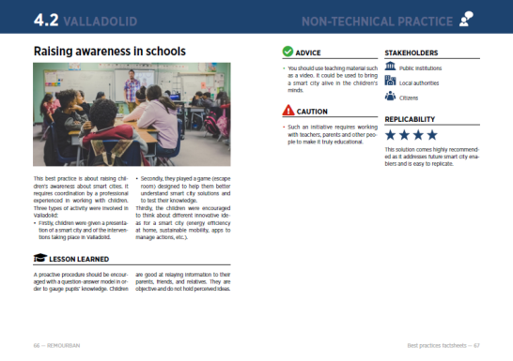
Best Practices Book

Slide 19

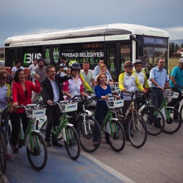
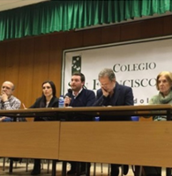
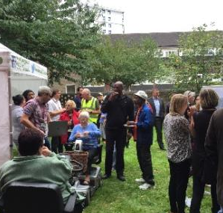
Citizen Engagement
Valladolid
Tepebaşı
Nottingham

Slide 20
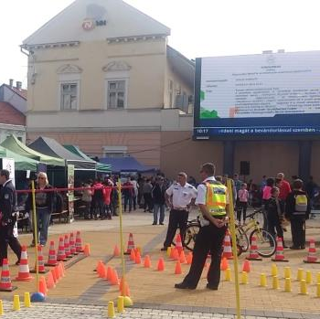
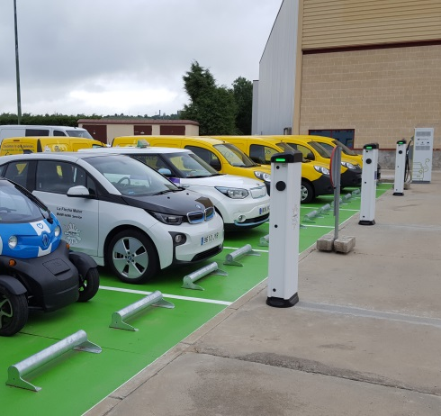
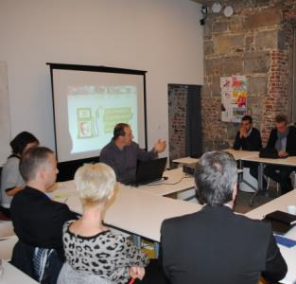
Citizen Engagement
Miskolc
Valladolid
Seraing

Slide 21
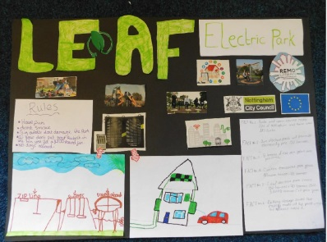
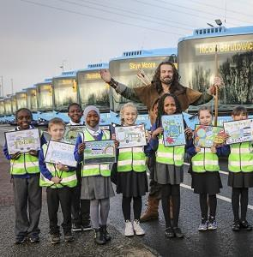
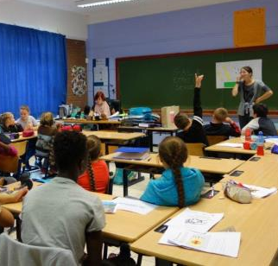
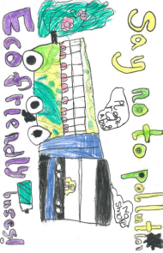
REMOURBAN with children

Slide 22

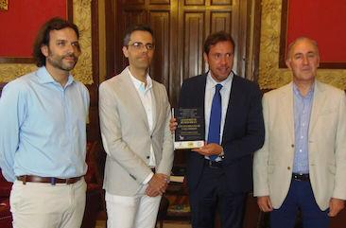
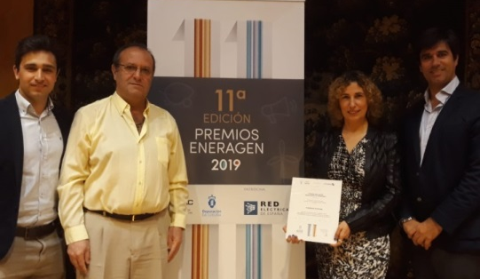
Awards
Green Solutions Awards. User’s Choice Award
Eneragen Awards – Energy Efficiency Category
“The best local development initiative in Castilla y León”
Valladolid
Valladolid
Valladolid

Slide 23
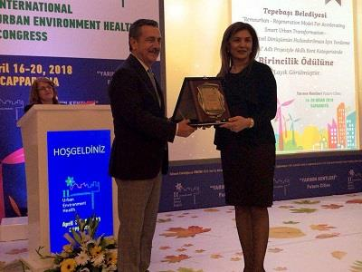
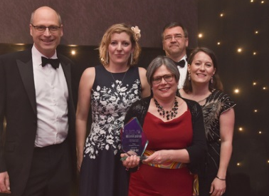
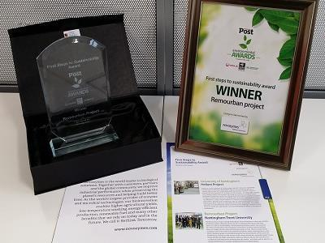
Awards
City of tomorrow
UK Housing Award for Innovation
Post Environmental Awards
Nottingham
Tepebaşı
Nottingham

Slide 24
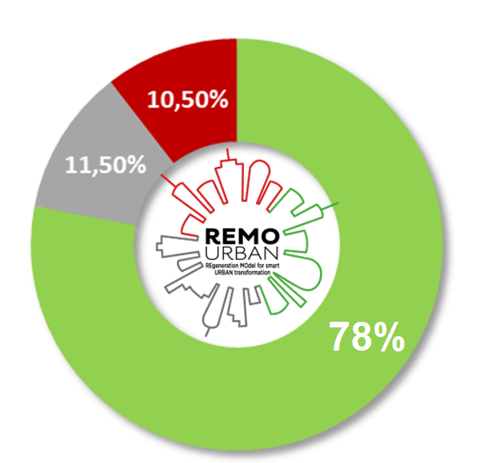
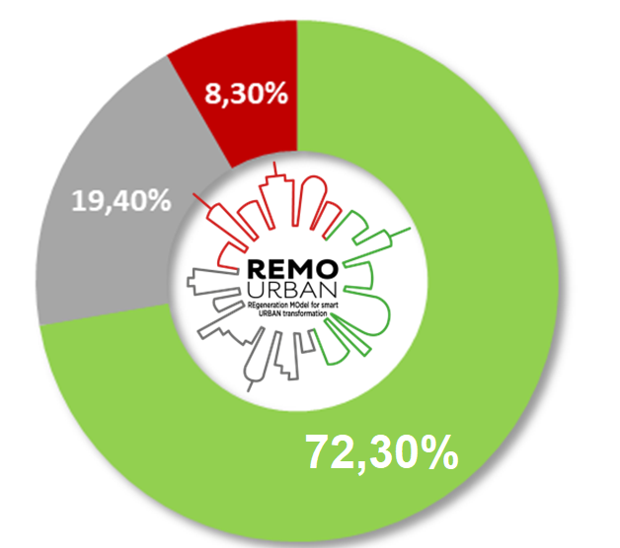
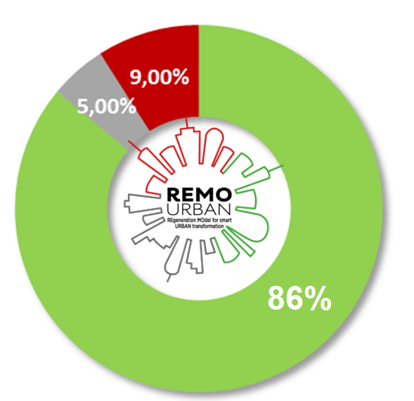
Social Acceptance
Valladolid
Nottingham
Tepebaşı

Slide 25

REMOURBAN
Cities

Slide 26




52%
56%
65%

Slide 27
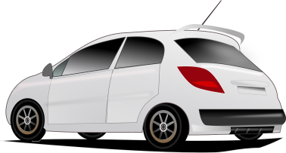





57
22
50
512 t/y

Slide 28




3 City Platform
> 900 sensors/meters
1.927 variables

Slide 29




20.000 citizens involved
> 590.000 online users
> 2.540 followers

Slide 30
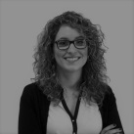






























































































































































Slide 31

Thank you!!

